Slide 1


Node.js, Socket.io & Express,js overview
Taken from [1]
Team Lambda
Daniela Sofia Carcausto Osco
Hazem Al Massalmeh
Nimesh Ghimire
Fabian Kvas

Slide 2
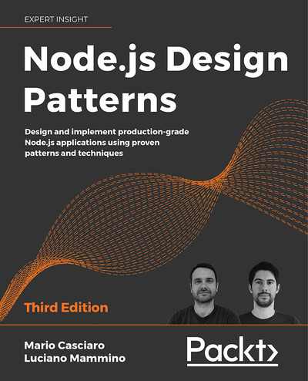

Node Section powered by
Node.js Patterns Chapter 1 & 2 [2]
Grokking concurrency Chapter 11 [3]

Slide 3

Agenda
Node.js
Express.js
Node.js overview
Socket.io
Express.js overview
Model, View and Controller
Getting Started with Node.js
Controller: Middleware and Routing
View: Templates
Model: Using Mongoose
Discussion & Installation
Adopted from Group Webscope, SoSe23
Notes:
Let’s have a short overview firstly.
You will learn Node.js, socket.io ,express.js and MVC.
after the class, you can build real time online chat application
I will show how to build
step by step.
Other group will introduce more details about express.js this Wednesday.

Slide 4
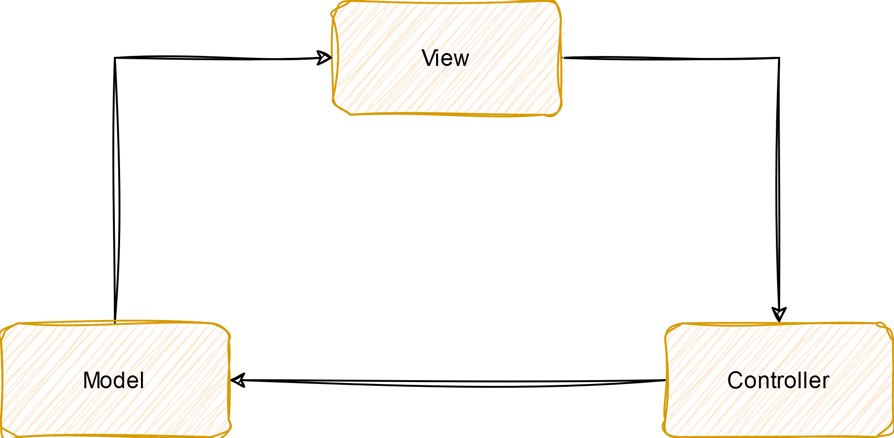
Quick recap of MVC
Model, View and Controller (MVC)
Design Pattern for GUI Applications
Characteristics
One-way databinding
Self-contained independent Layers
Widely adopted

Slide 5
Agenda
Node.js
Express.js
Node.js overview
Socket.io
Express.js overview
Getting Started with Node.js
Comparison & Summary
Controller: Middleware and Routing
View: Templates
Model: Using Mongoose
Discussion & Installation
Notes:
First part: node.js

Slide 6
Node.js Overview
But why? And how?

Slide 7
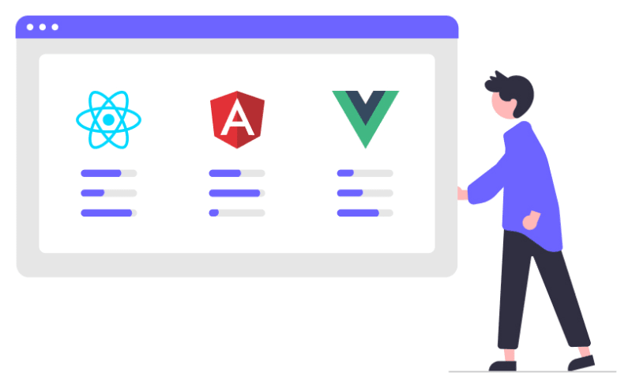
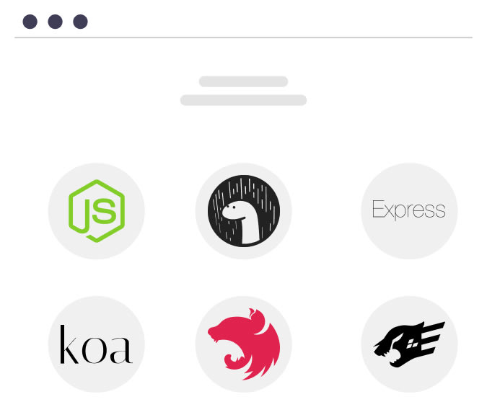

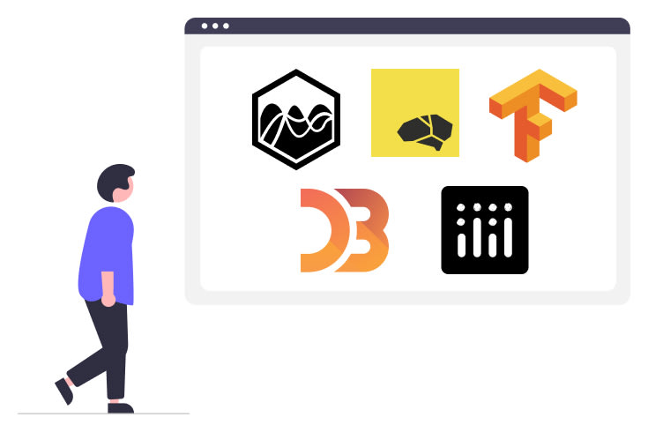
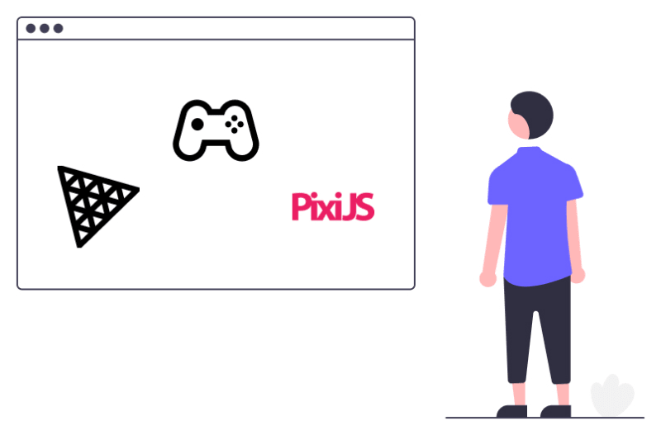
Using JavaScript everywhere
Front-end
Back-end
Data Science and Visualization
Mobile-application
Game
Source: JavaScript use-cases and most popular technologies used with JavaScript [5]

Slide 8
Why JavaScript?
JavaScript
Well-known amongst web-developers
Widely used for non-blocking operations
Easy to learn
Fun to use (allegedly)

Slide 9

Node.js – A JavaScript runtime
JavaScript runtime environment built on Google’s V8 Engine
Allows executing JavaScript code outside of a web browser
Enables server-side and command-line application development
Source: 10 Reasons To Learn Node.js In 2024 [6]

Slide 10
Characteristics of Node.js
Not Single-threaded [1 - 3, 5, 6]
Non-blocking I/O operations
Wide range of modules and libraries available using npm
Large active community
Scales well regarding served requests

Slide 11

Use case – Backend
Handles processing and storage of data
Receives requests from the frontend, and responses with data

Slide 12

Node.js – Example Backend
Node.js is a runtime for JavaScript on the server side
Express.js is a flexible Node.js web application framework
MongoDB is a NoSQL database
Source: Setting Up MongoDB with Express.js: A Step-by-Step Guide [9]

Slide 13

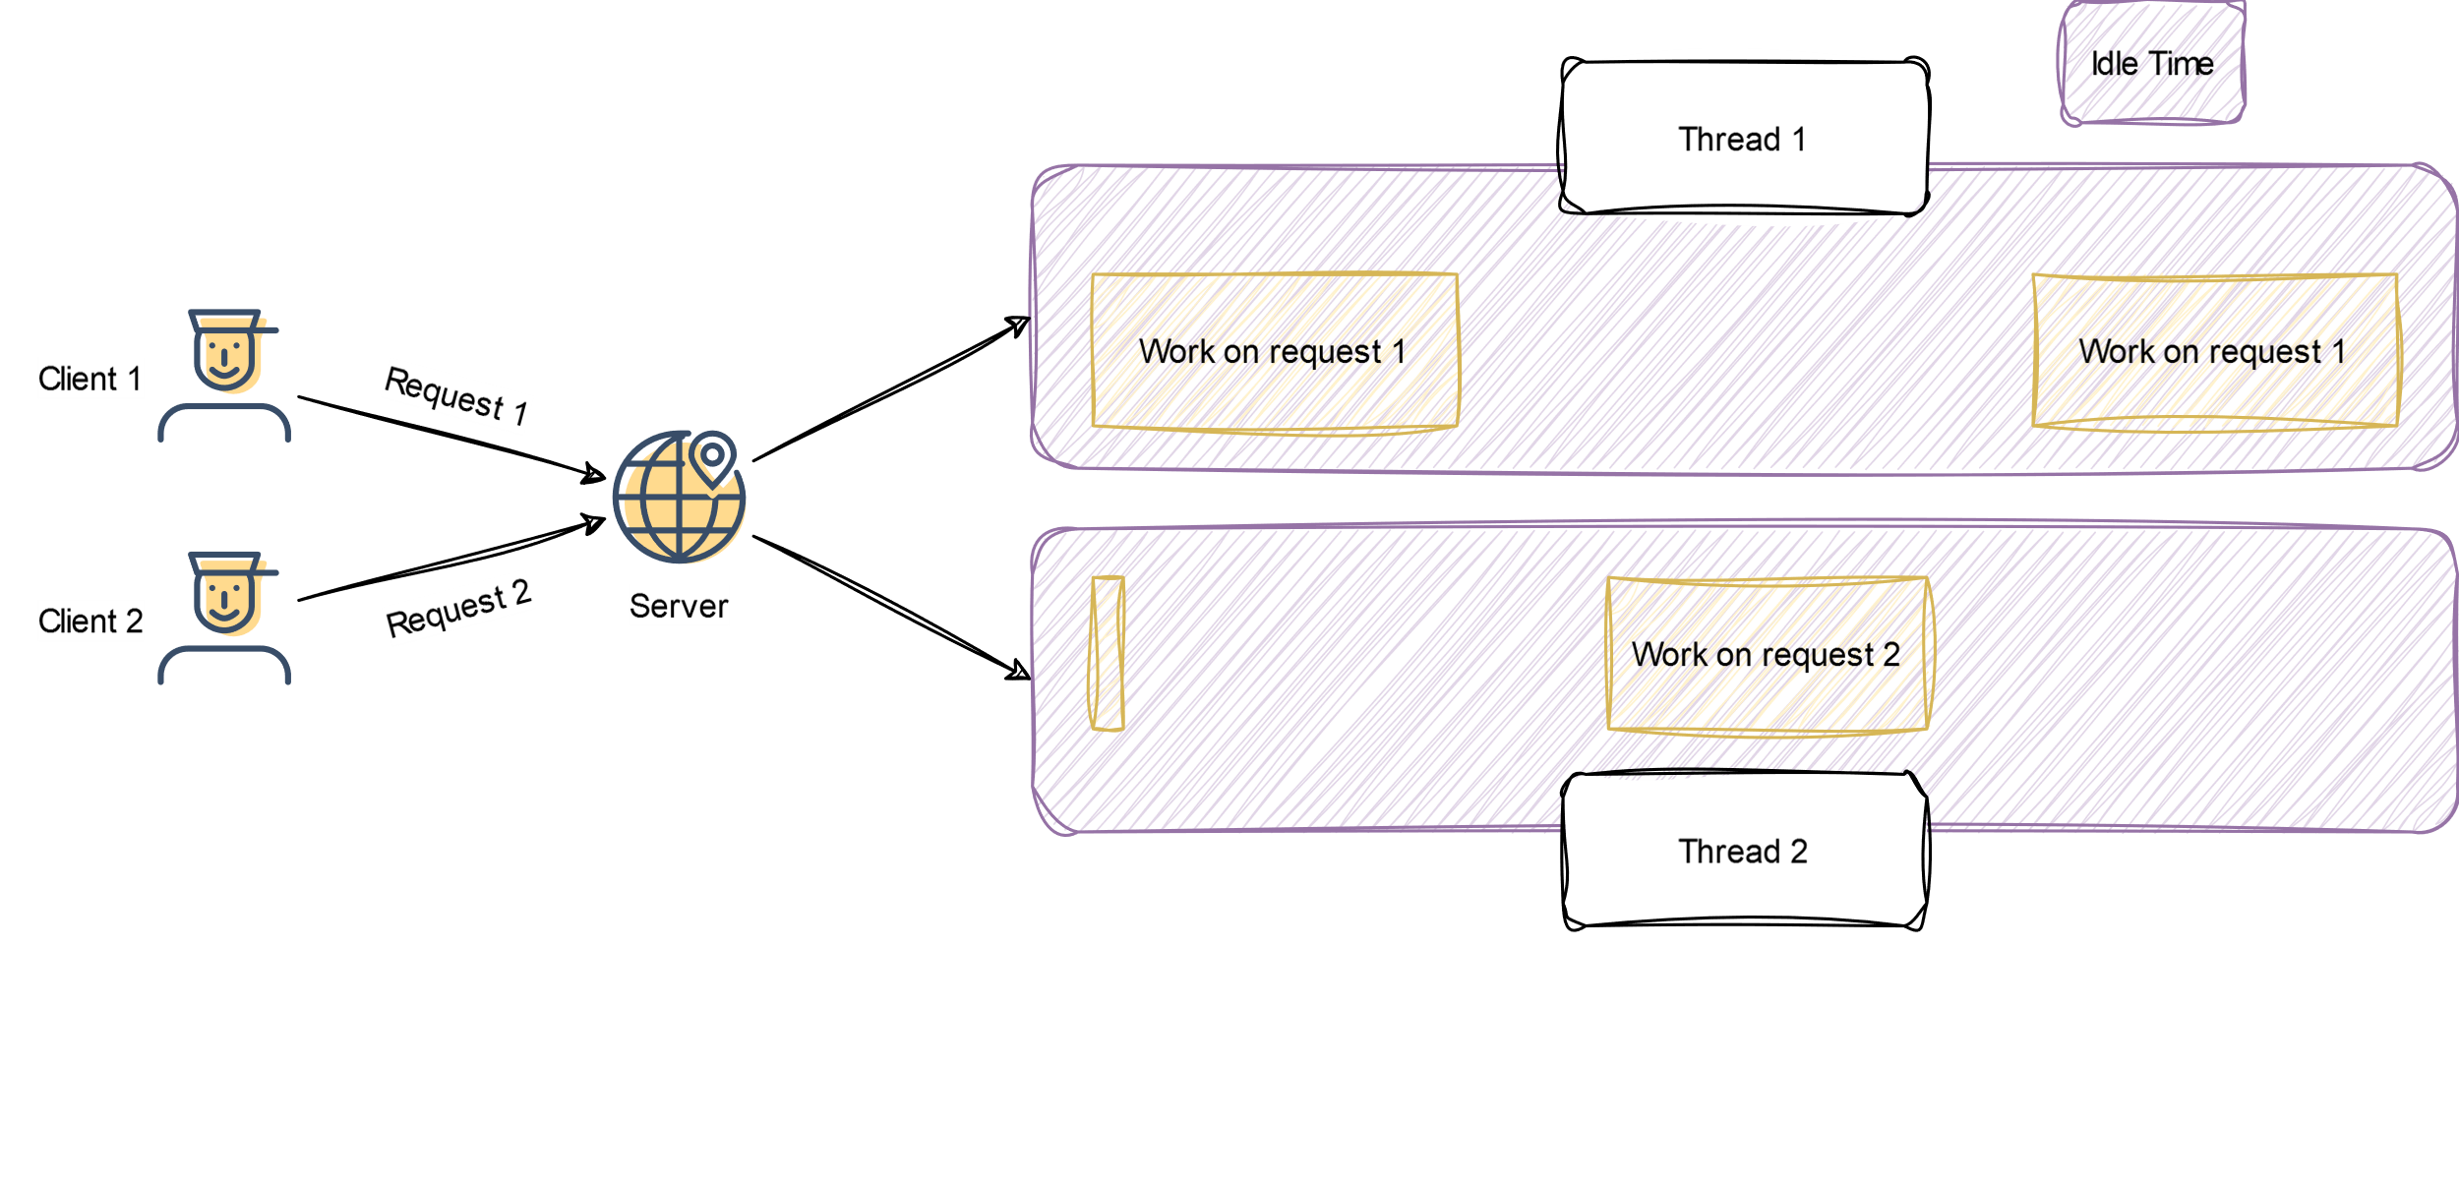
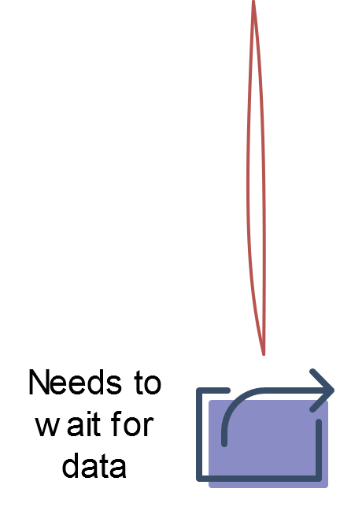

Handling Requests – Multithreading
When a task needs to wait for data,
it is I/O Bound

Slide 14






Excursion – I/O Bound Tasks
CPU
Cache
RAM
I/O Bound task are slow, but not because of the CPU
External
Storage

Slide 15
Multithreading Problems
Inefficiency for I/O bound Tasks
I/O operations block threads
and waste CPU cycles
Complexity and Debugging
Race conditions, Deadlocks and starvation
Scalability Issues
Thread management requires sophisticated thread pooling mechanisms

Slide 16
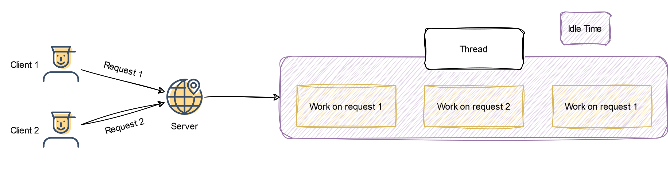
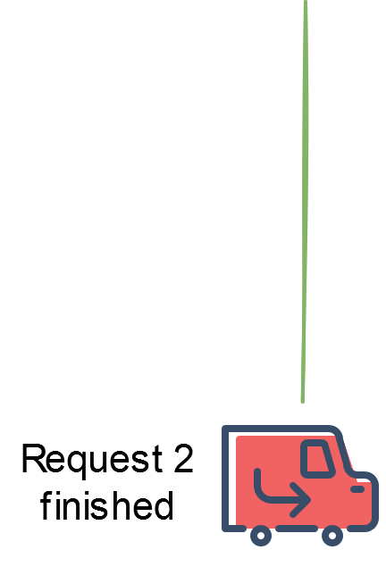

Handling Requests – a better Approach

Slide 17
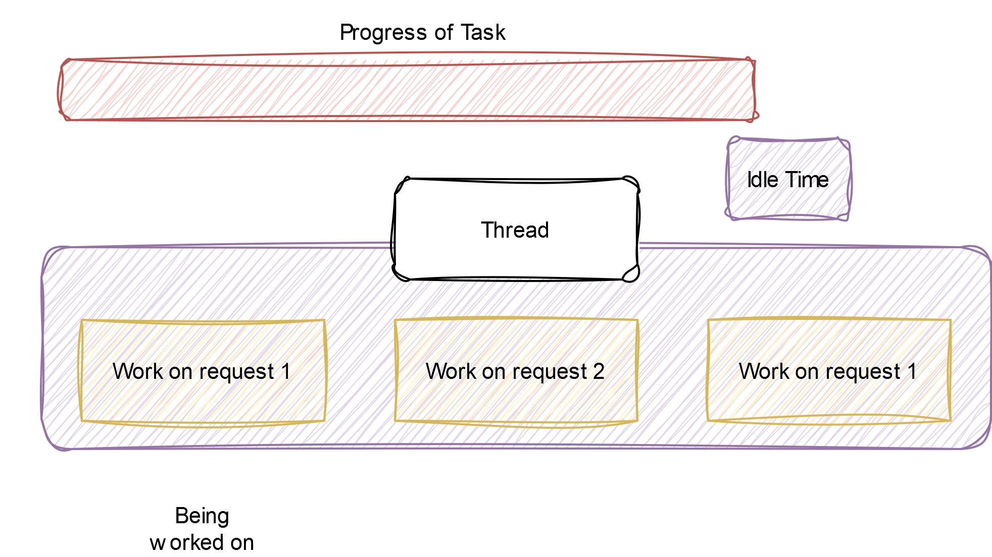


Concurrency Example

Slide 18
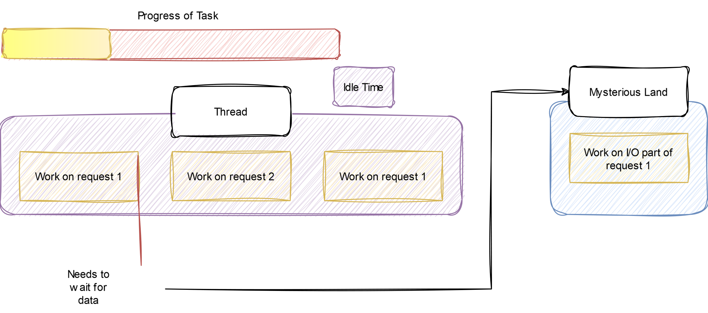

Concurrency Example

Slide 19
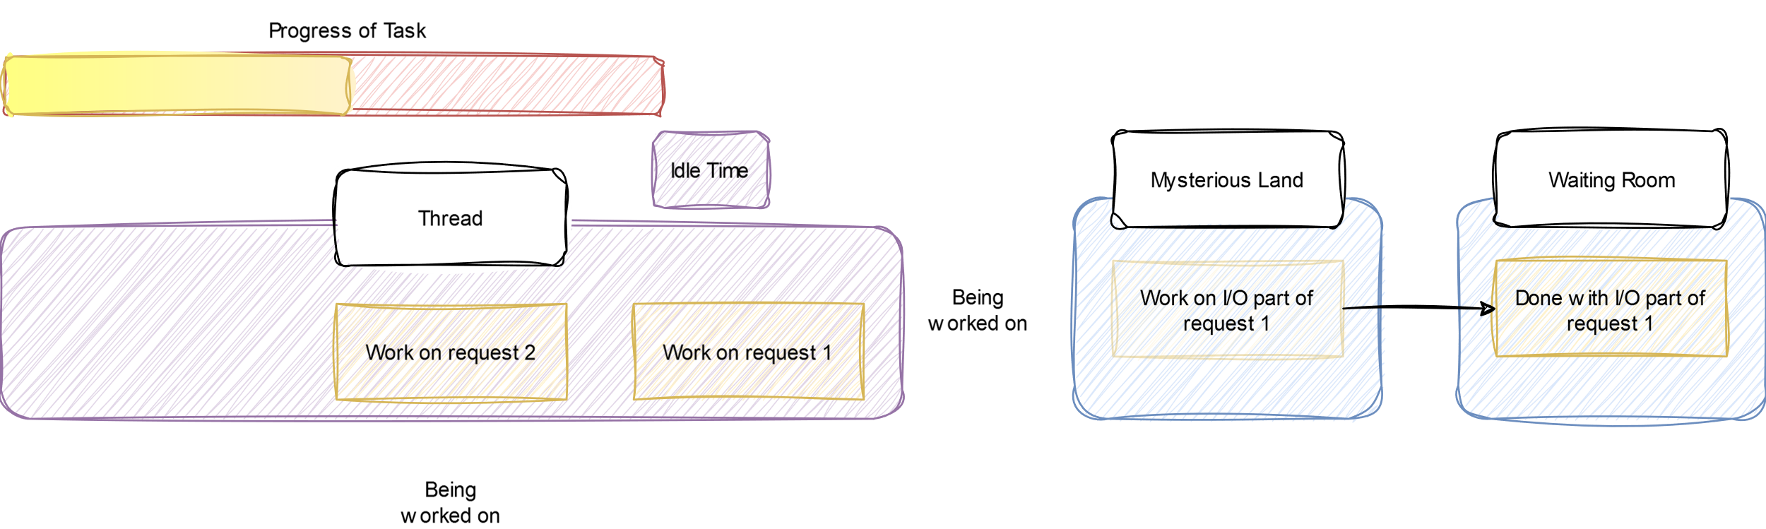
Concurrency Example

Slide 20
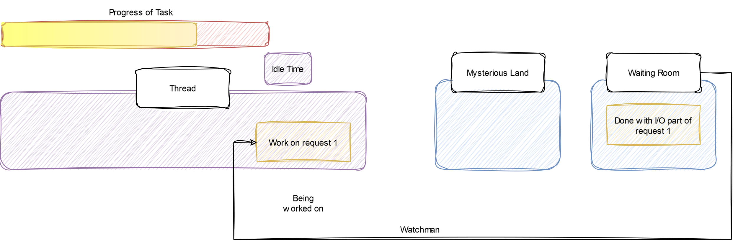

Concurrency Example

Slide 21
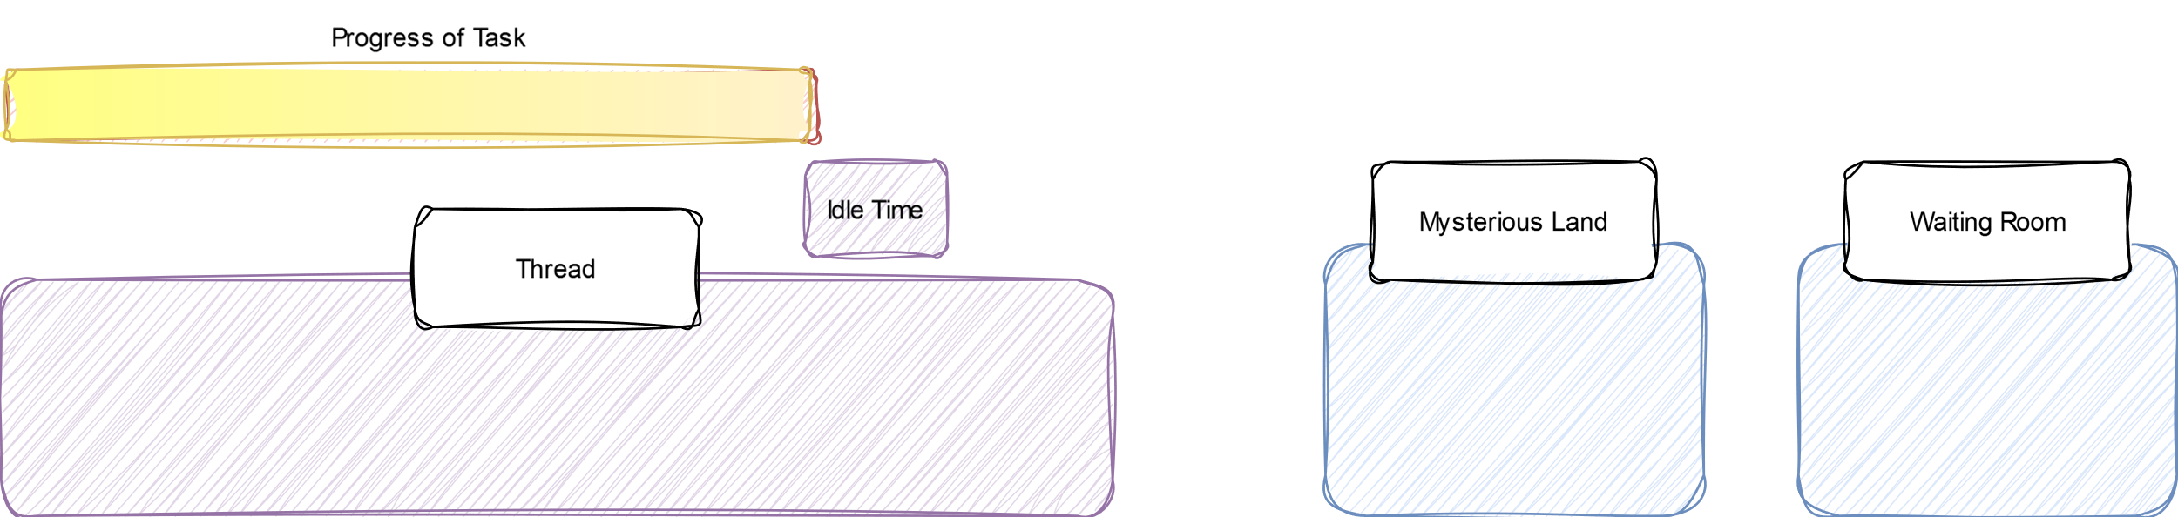
Concurrency Example

Slide 22

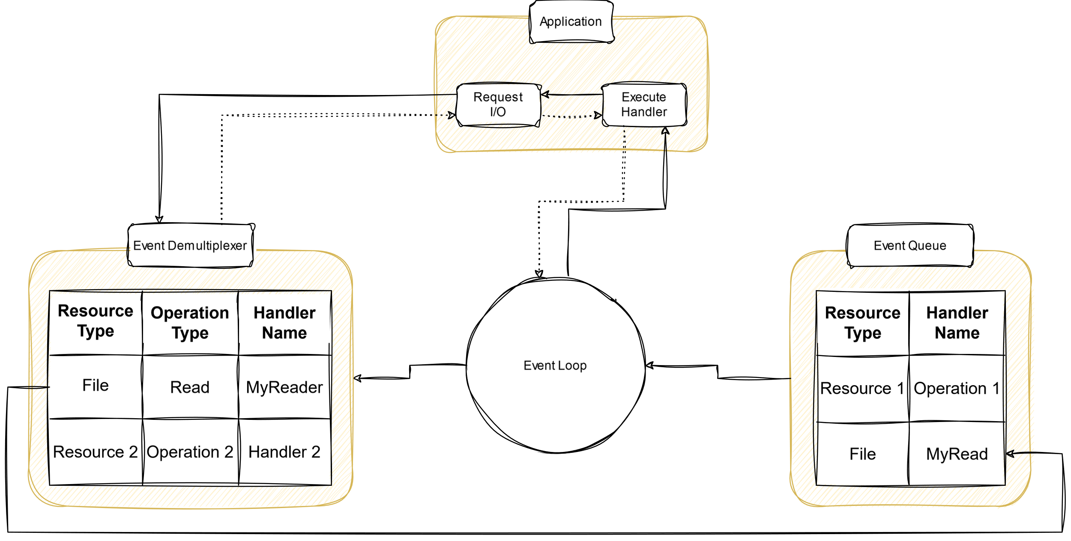
Reactor Pattern – At the Core of Node.js
Thread
Mysterious Land
Waiting Room
Watchman

Slide 23
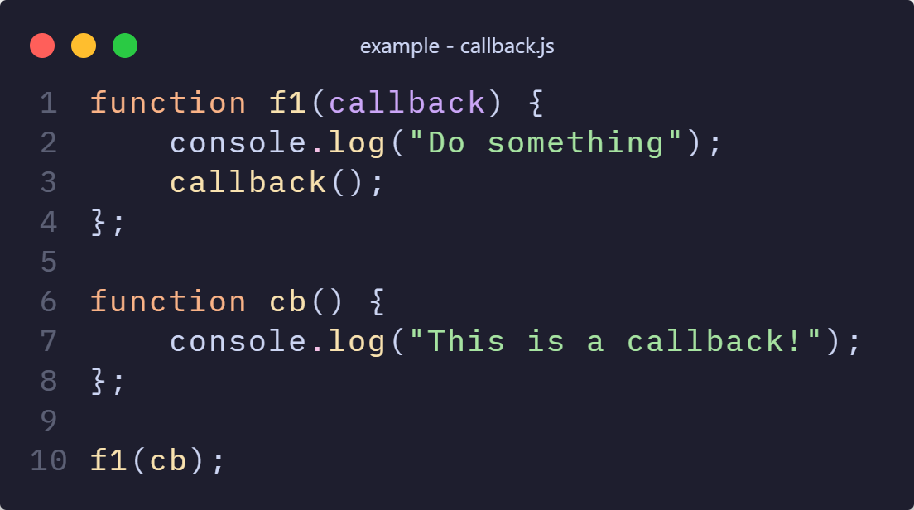
Asynchronous Functions – Callback
Functions in JavaScript are Objects
Objects can be passed to functions as parameters
Execute callback as last action of a function

Slide 24
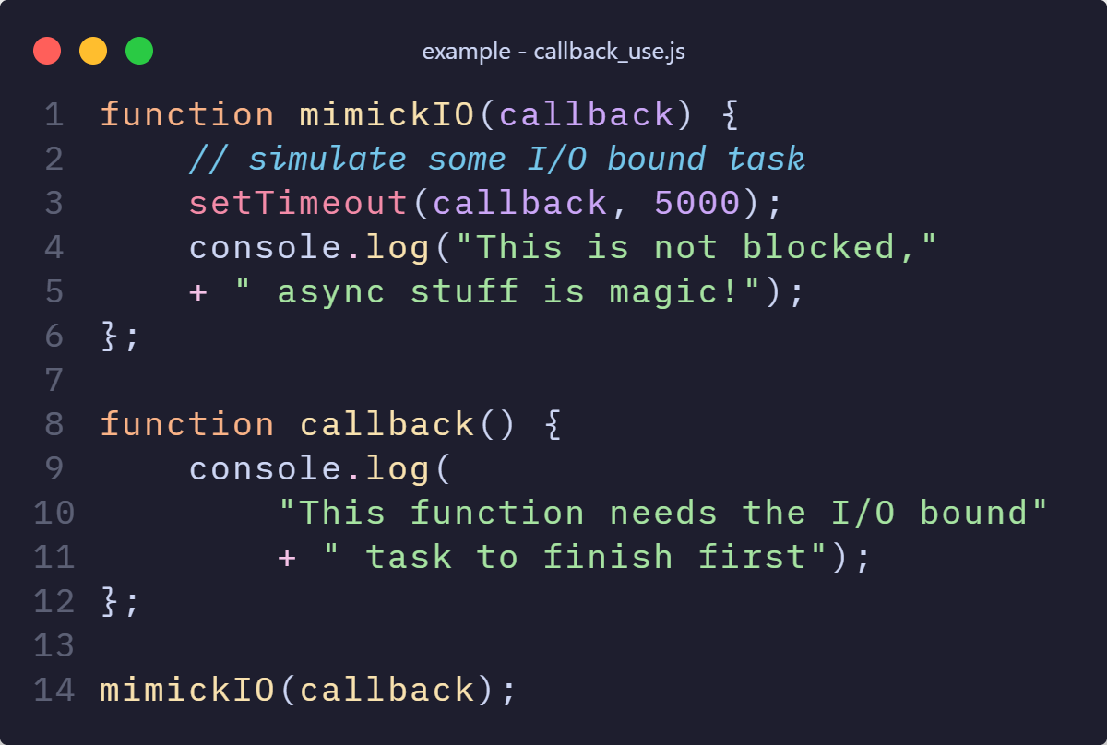
Asynchronous Functions – Callback
Your own functions are not truly asynchronous
Some native API functions are truly asynchronous
Create callbacks to not block the event loop

Slide 25


DEMO

Slide 26
Asynchronous Functions – Promises
Represent future completion or failure of async operation
Resolution or Rejection can be used
Promise.then( cb(success) ).catch( cb(error) )
Objects that resolve or reject
new Promise((resolve, reject) => { … })
Same function as callbacks
Promise code ‘looks’ like synchronous code

Slide 27
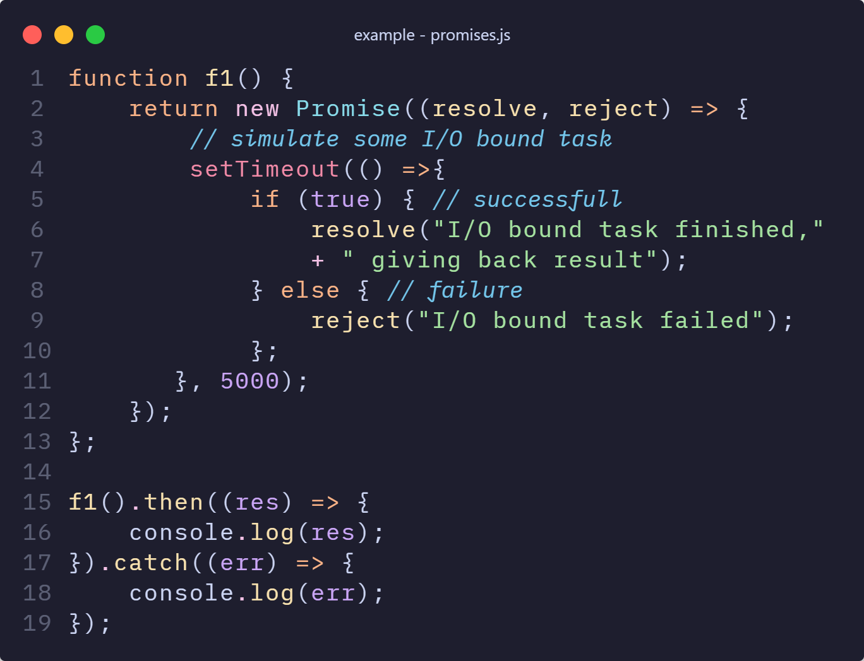
Asynchronous Functions – Promises

Slide 28
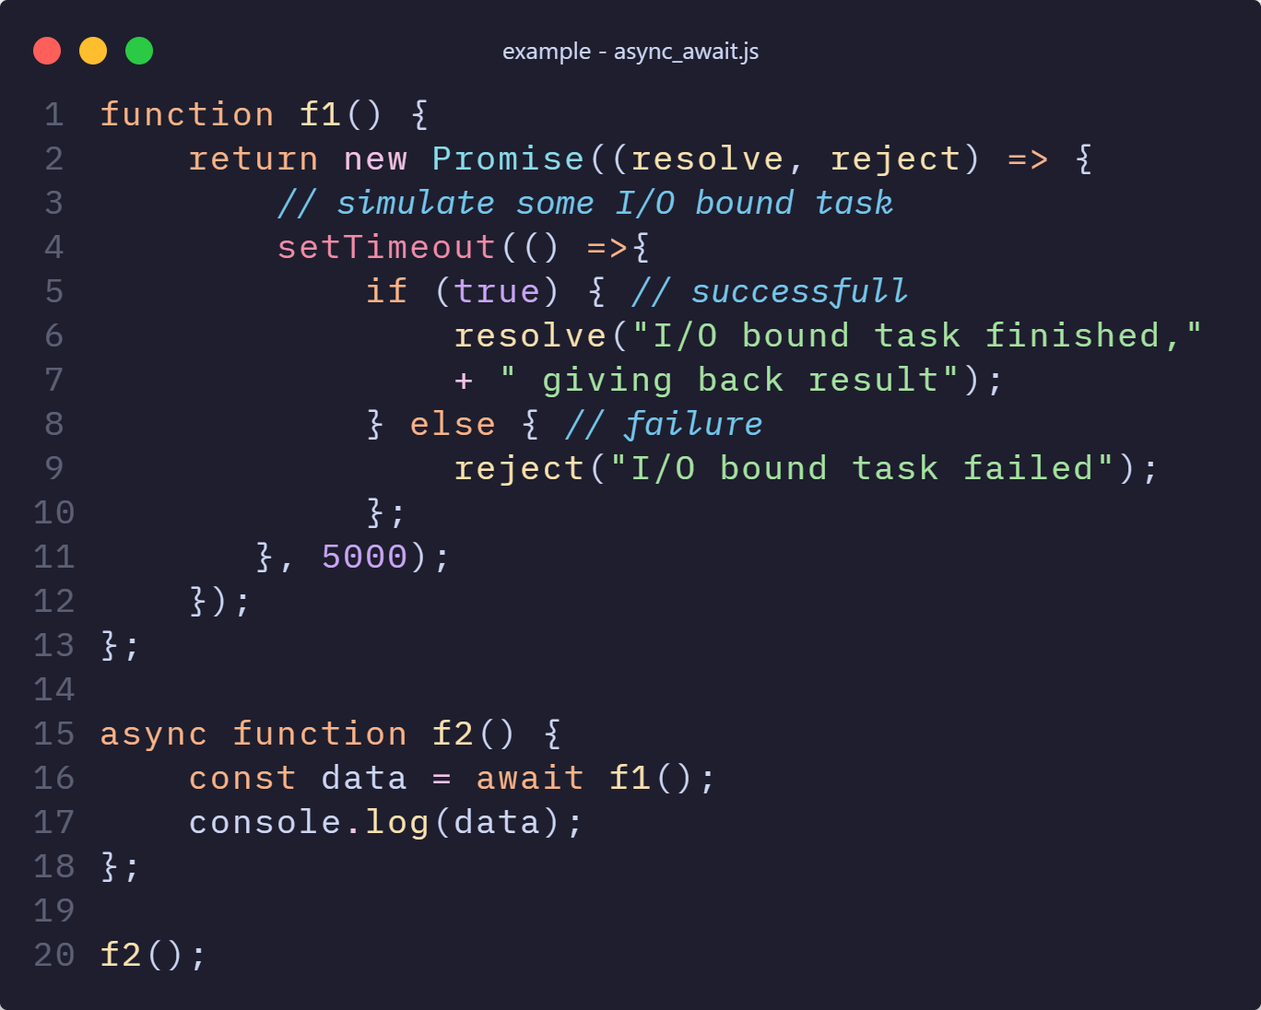
Asynchronous Functions – Promises
async/await are syntactic sugar to utilize promises
async wraps the return value of a function in a promise
await pauses execution until a promise resolves or rejects

Slide 29

DEMO

Slide 30
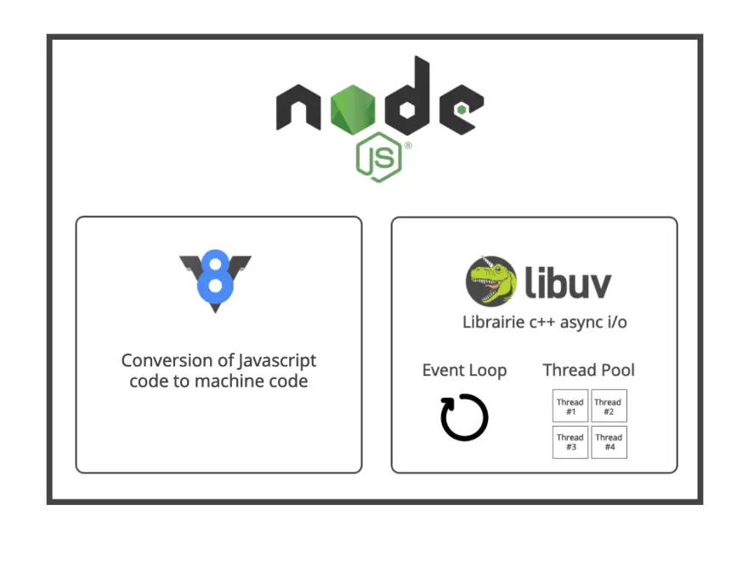
Key Takeaway
V8
Google’s open-source high performance JS engine
written in C++
libuv
multiplatform C Library
Core functionality for event loop, thread Pool and event Demultiplexer
Bridge between Node.js and OS
Source: Create a backend in Javascript (part 6): How NodeJS work under the hood [10]

Slide 31
Key Takeaway
Event Loop
Continuously checks the event queue for pending events
Executes event handlers
Event demultiplexer blocks the Event Loop until new events are available
Thread Pool
Modules like fs, crypto, database operations take more time to process
To avoid blocking the main thread the Thread Pool is used
The default size is 4

Slide 32

Modules
Building blocks to structure the program
Single file or a collection of multiples files/folders
Real world JavaScript applications are split into multiple files
“Make each program do one thing well”

Slide 33

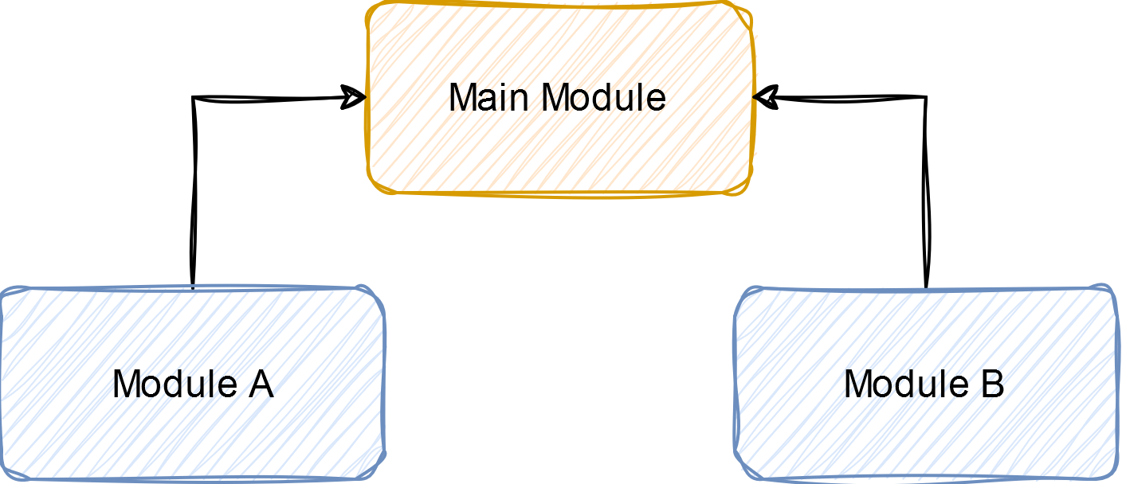
Modules
The Main module is usually App.js

Slide 34
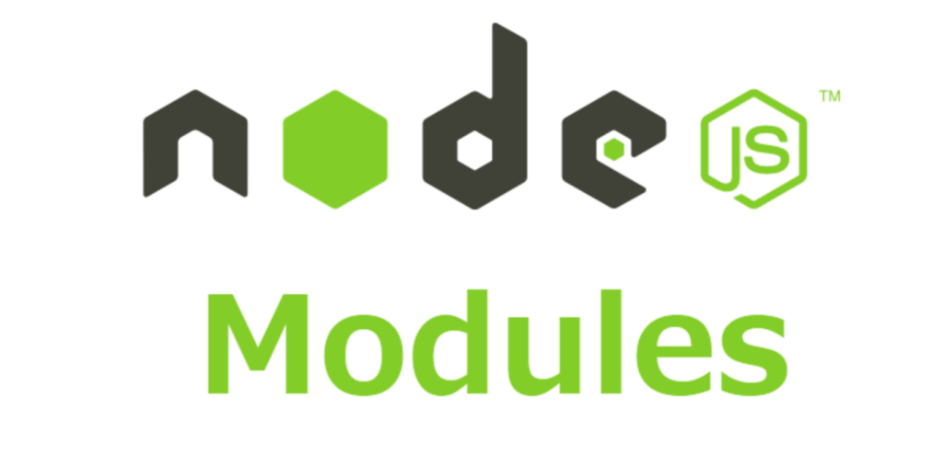
Advantages of using modules
More structure to the program
Can be shared and reused
Modules prevent naming conflicts
Split into smaller files with self-contained functionality
Source: NodeJS Modules| How to create Modules in Nodejs [11]

Slide 35
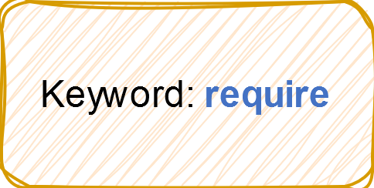
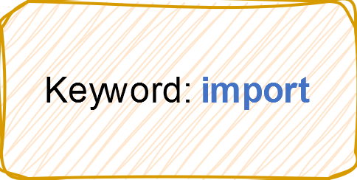
Module systems
Common JS
ECMA (ESM or ES) Modules
Does not work in browser
Old
Older projects rely on it
Synchronous
Use them in browser
Modern
The new standard
Asynchronous

Slide 36
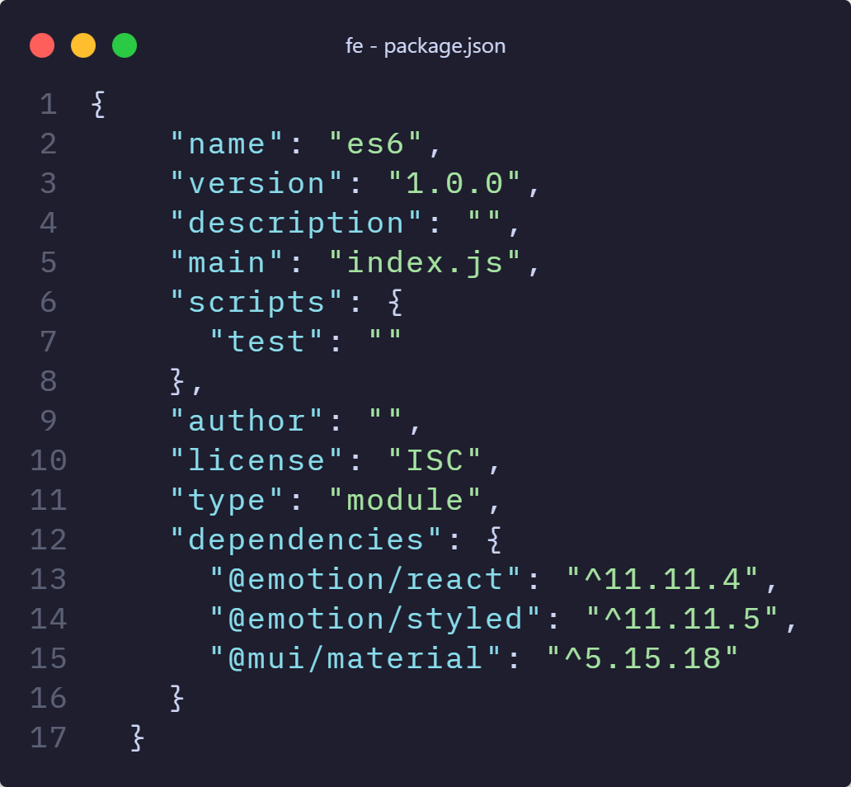
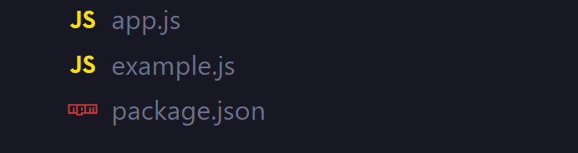

ECMA Module – How does Node.js know?
1st Step
2nd Step
.mjs extension works as well!

Slide 37
Types of Modules
Built in models/Core models
Local modules
Third party libraries

Slide 38
Built-in modules
Used without installation
Don't require a specified path
Commonly used modules
http
fs
Stream
Os
Path
process
Module | Function
http | Make Node.js transfer data over HTTP
fs | Working with the computer's file system
Stream | Handling streaming data
Os | Info about operation system
Path | Directories and file paths

Slide 39

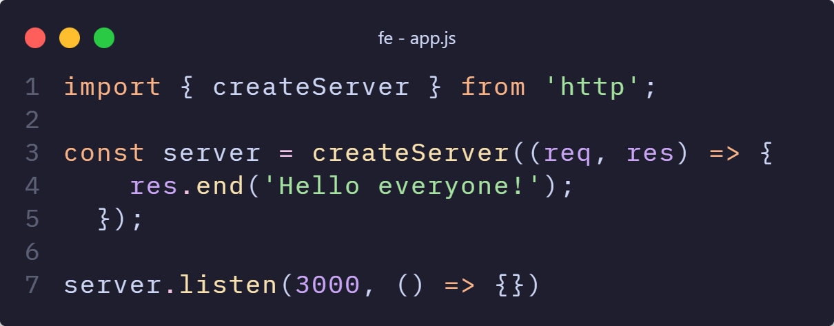
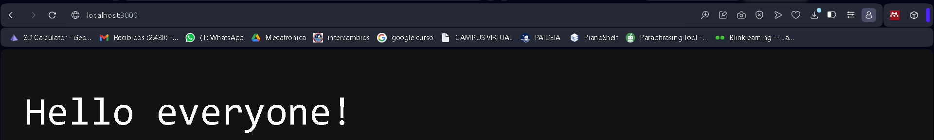
Built-in module example
Creating a server!
‘Module name’
Creating server instance
Setting a port

Slide 40

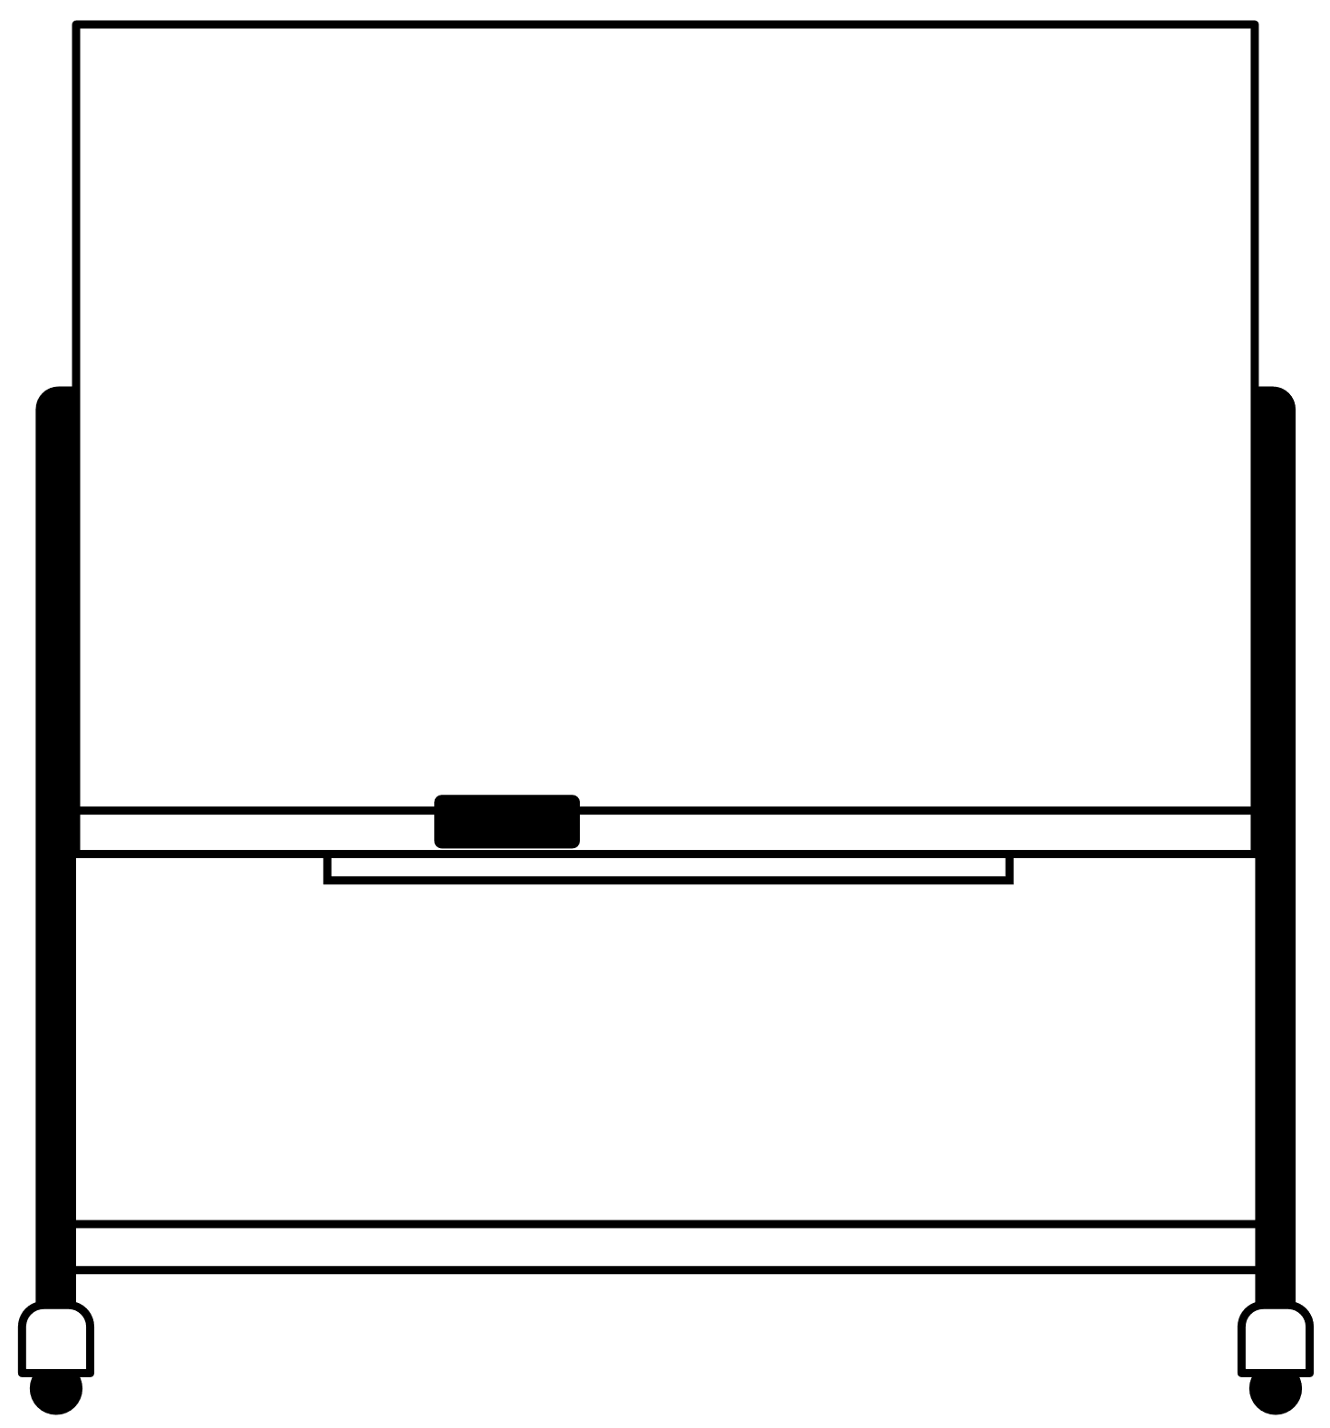
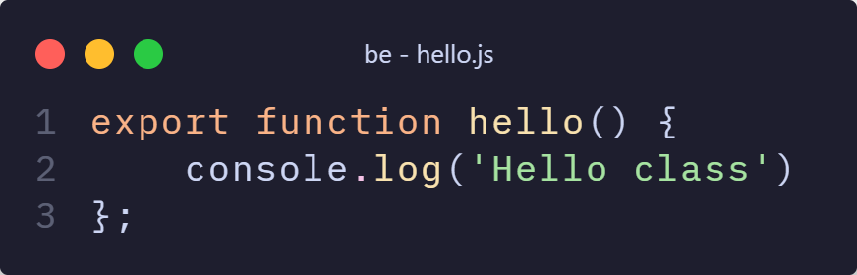
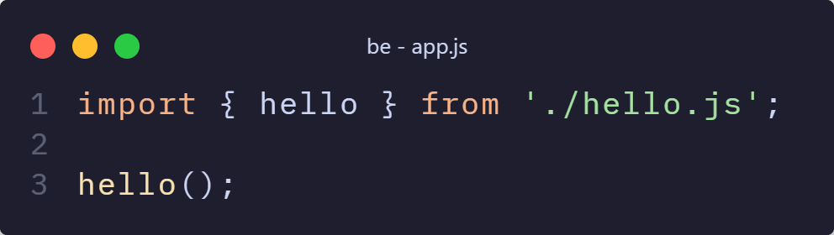
Local modules – The ones we create
Creation of a file
Exportation of something
Importation of something
creation
exportation
importation
Result!

Slide 41






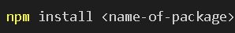

Third party libraries
Modules available by using Node Package Manager (npm)
To use them:
Example packages
Express
Moongose
Check what you install!
Installation
Importation

Slide 42
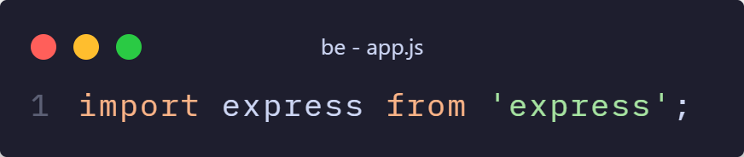
Example
Installation in terminal
Now we can access to the functions of express!

Slide 43
The philosophy of Node.js
A small core [2]
Don’t Repeat Yourself (DRY) approach [2]
Small surface area [2]
Simple and pragmatic, Keep it Simple, Stupid (KISS) principle [2]

Slide 44
Agenda
Node.js
Express.js
Node.js overview
Socket.io
Express.js overview
Getting Started with Node.js
Comparison & Summary
Controller: Middleware and Routing
View: Templates
Model: Using Mongoose
Discussion & Installation
Notes:
First part: node.js

Slide 45
WebSockets & Socket.io
I am feeling a connection, but are you not a bit too pushy?

Slide 46
Front-End & Back-End
Front-End
Back-End
Client
facing
Server
Responsive
State
Lightweight
Heavy
lifting

Slide 47



How the Web works
What a nerd
Clients communicate through a protocol
WebSockets allow for stateful, bidirectional and full duplex communication
There are many protocols, such as HTTP/S, UDP and TCP

Slide 48
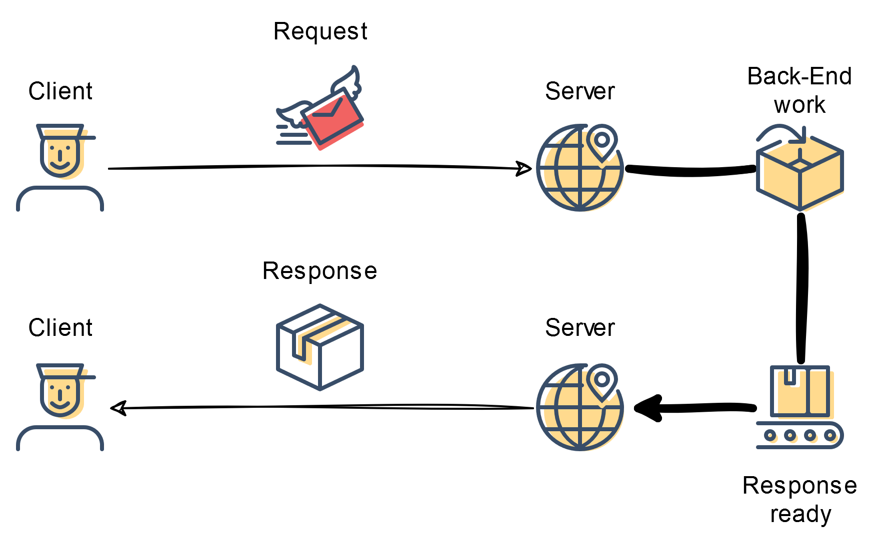
HTTPS
Hypertext Transfer Protocol Secure (HTTPS)
The de facto standard for Web communication

Slide 49

DEMO

Slide 50
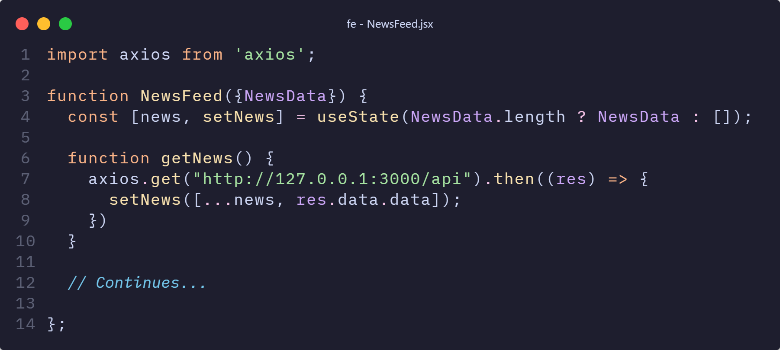
The inner workings – HTTPS – Front-End

Slide 51
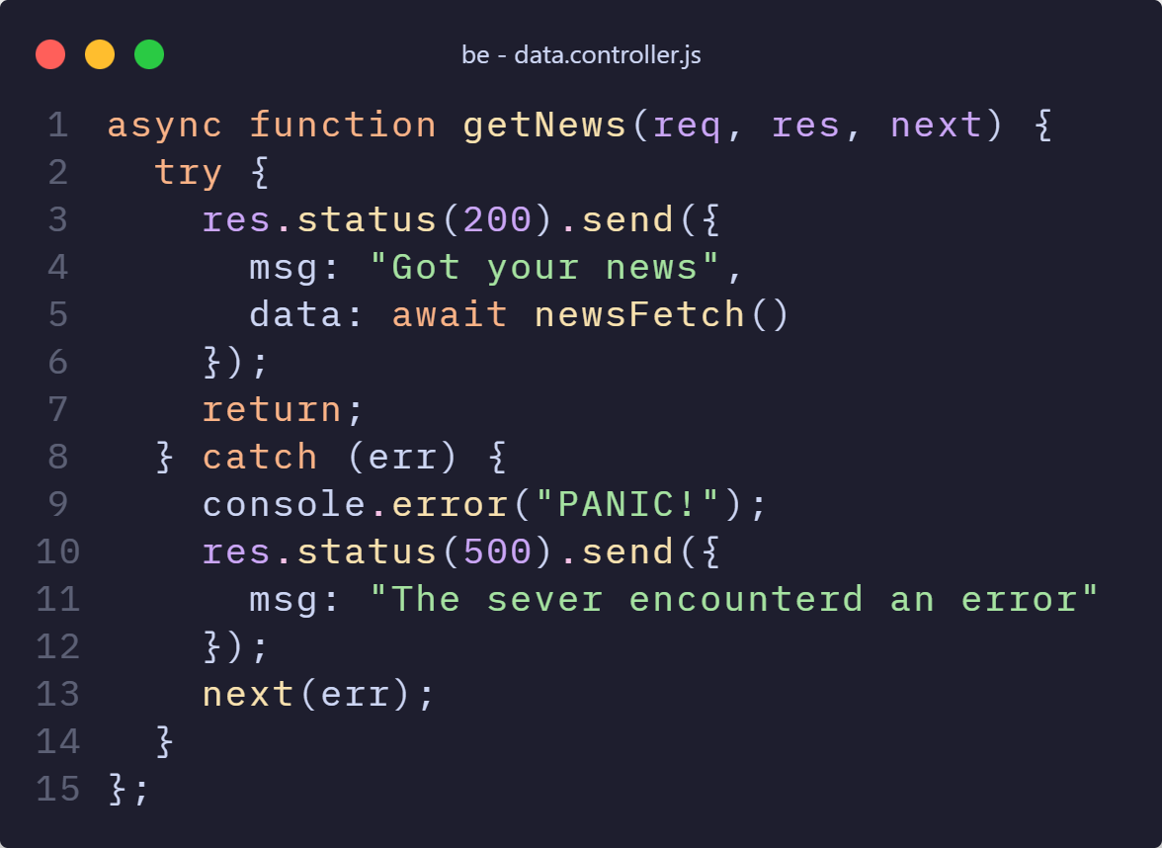
The inner workings – HTTPS – Back-End

Slide 52
The WebSocket Protocol
WebSocket Protocol is defined by the IETF in RFC 6455 [9]
Secure
real-time
two-way communication
Works by initial HTTP handshake followed by TCP communication [9]
Source: WebSocket Protocol [13]

Slide 53
WebSockets TL;DL
Allow for stateful, bidirectional and full duplex communication
Establishes long-lived and persistent connections via. TCP
(Relative) efficient data transferer between processes
(Relative) secure communication
Full duplex means that transmission and reception can happen simultaneously

Slide 54




What?

Slide 55
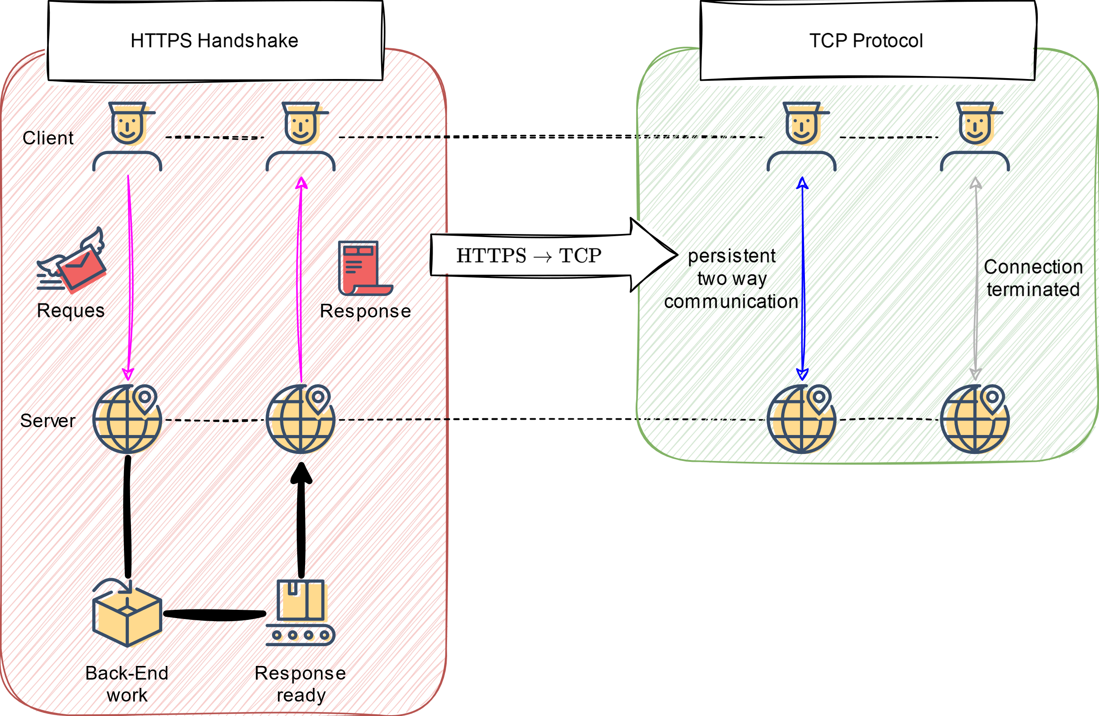
WebSockets – Easy to abstract

Slide 56
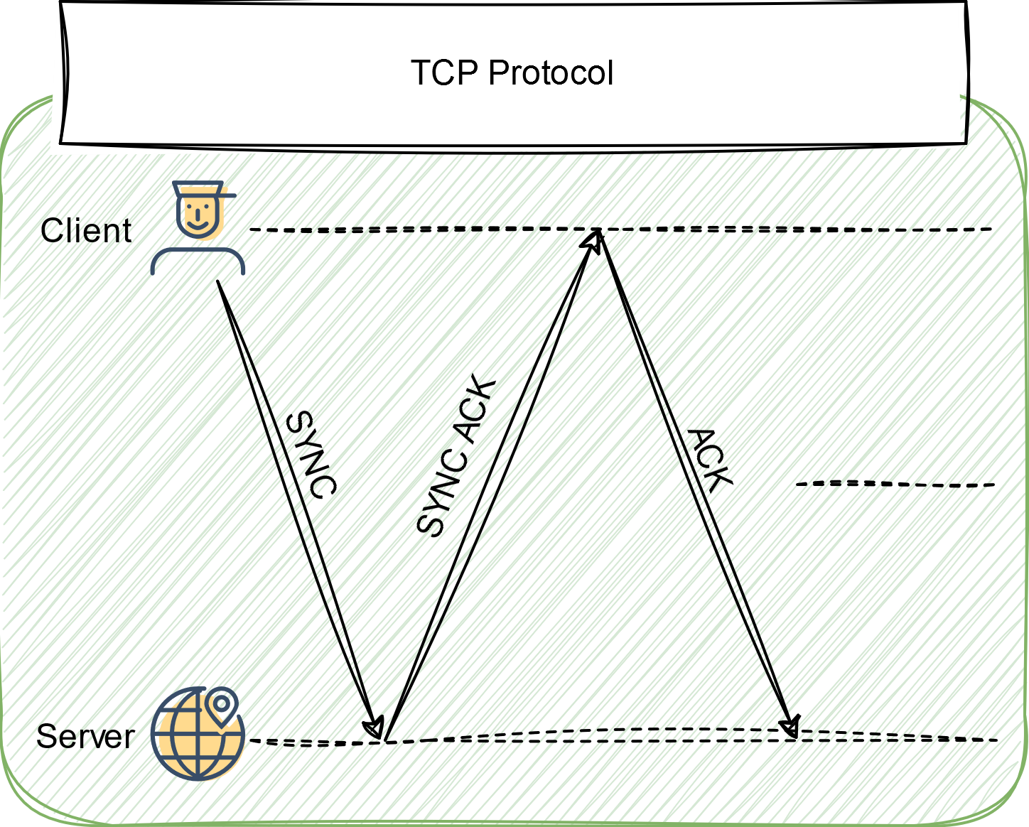
WebSockets – Easy to abstract – TCP

Slide 57
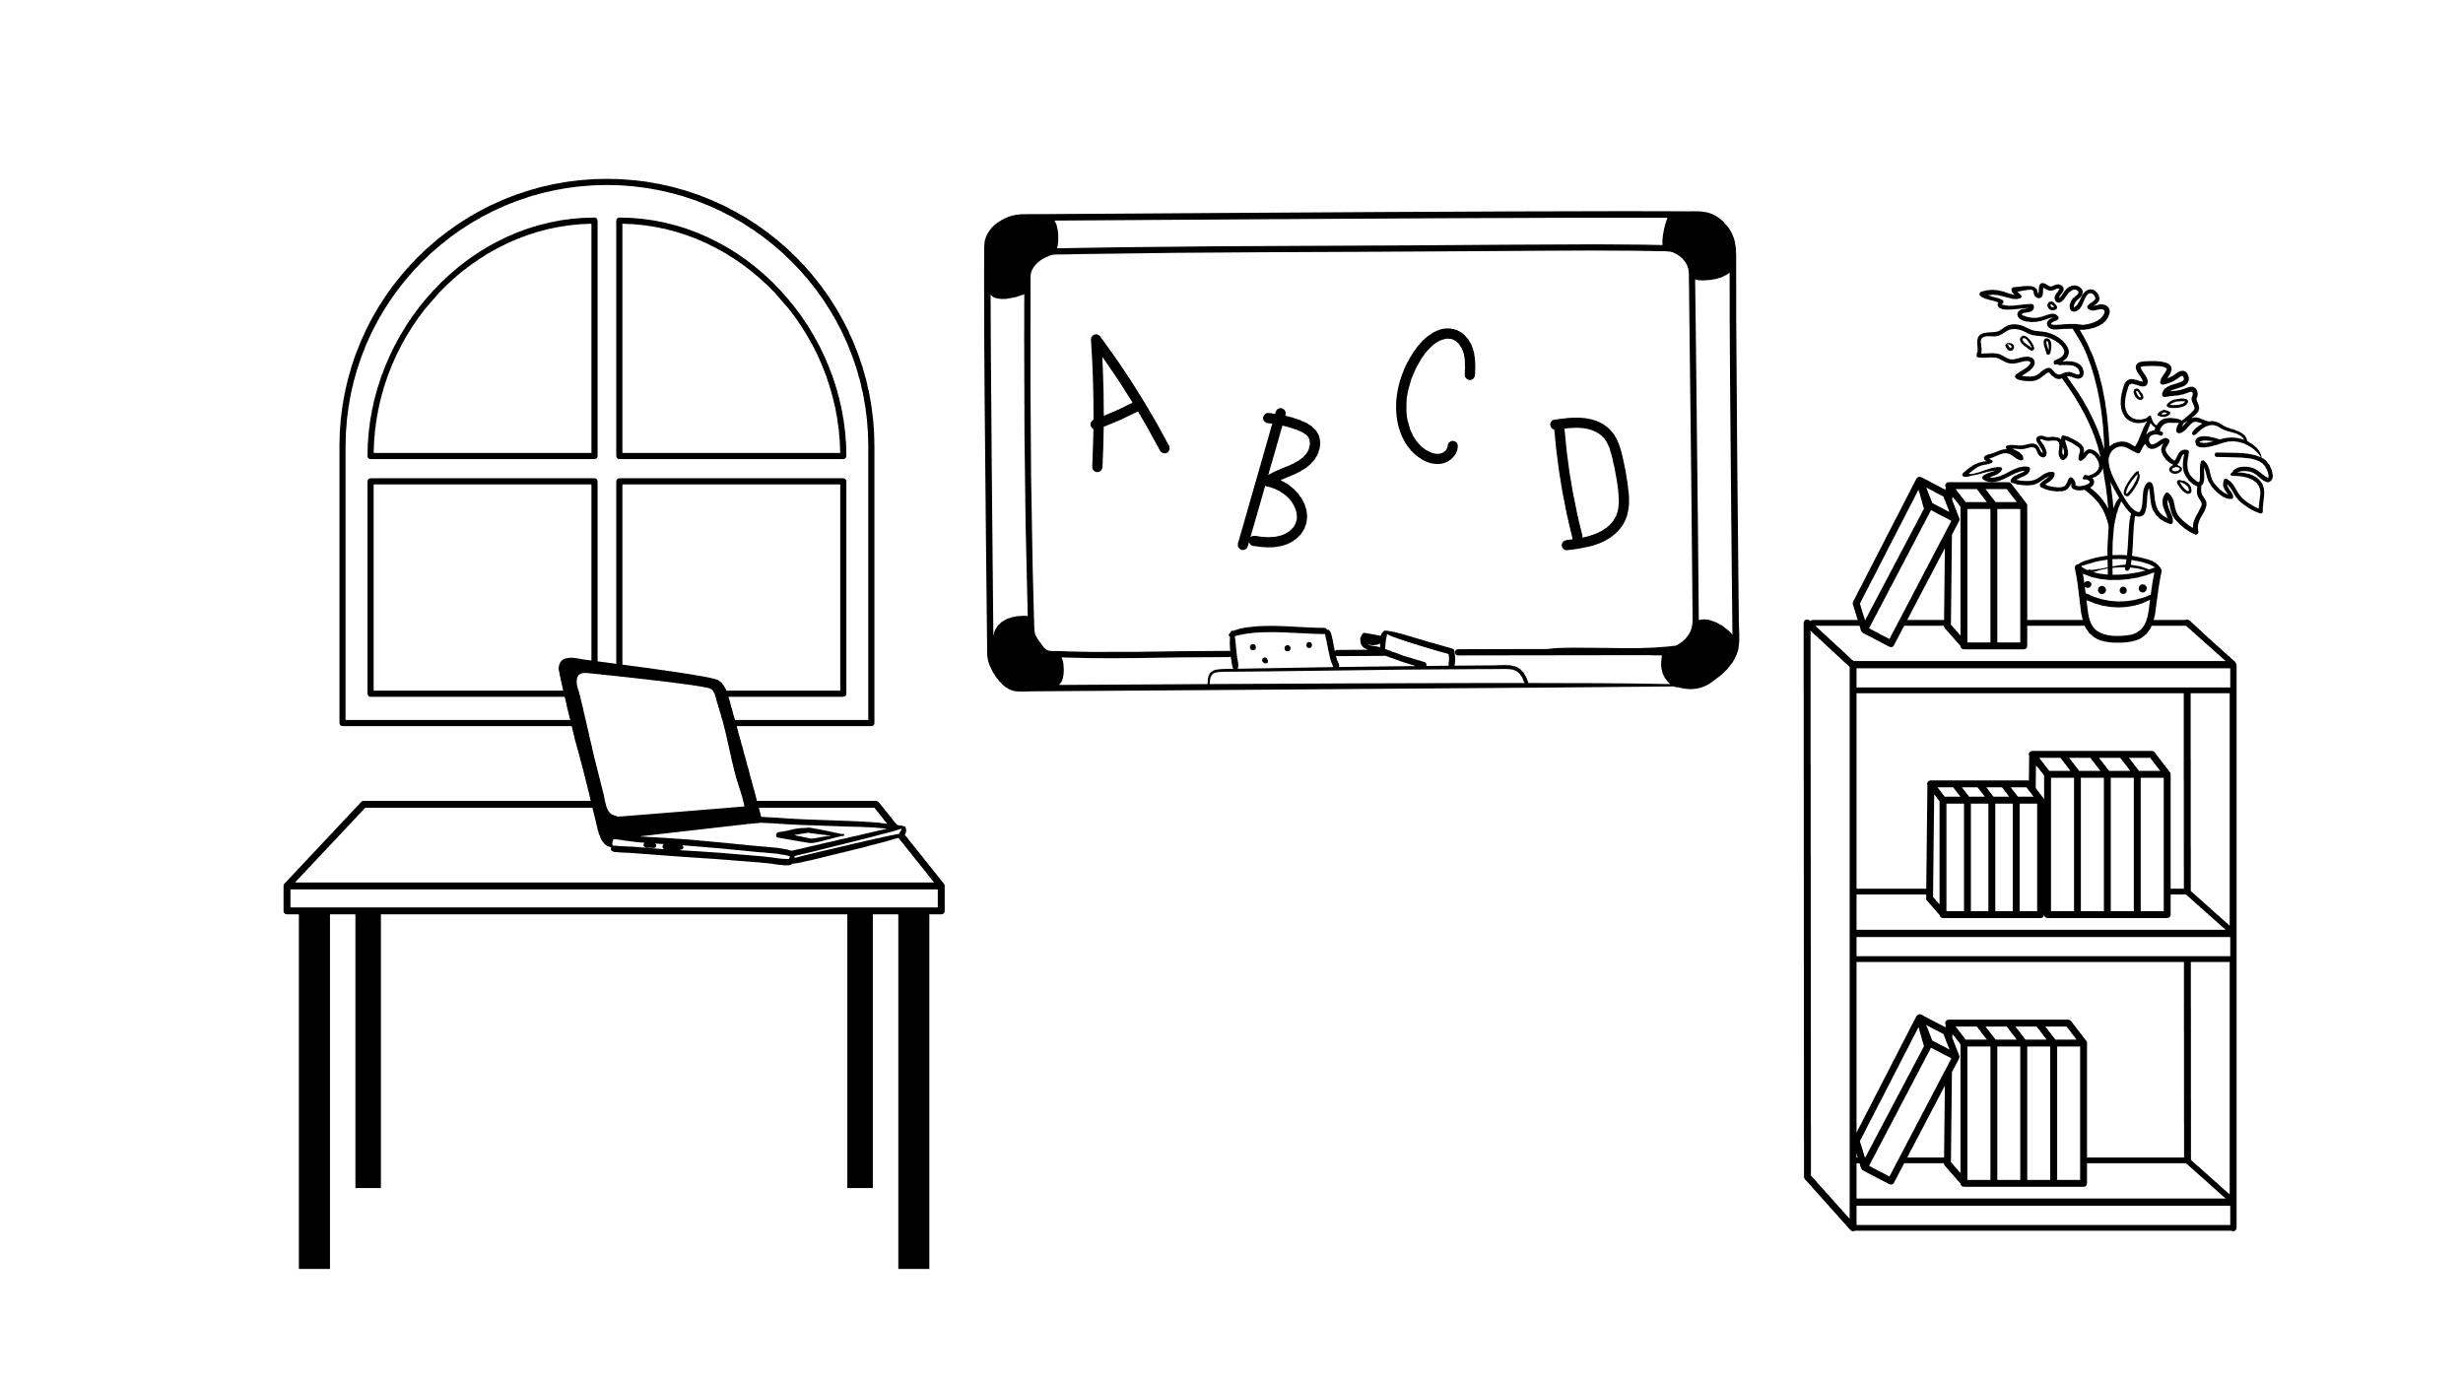
DEMO

Slide 58
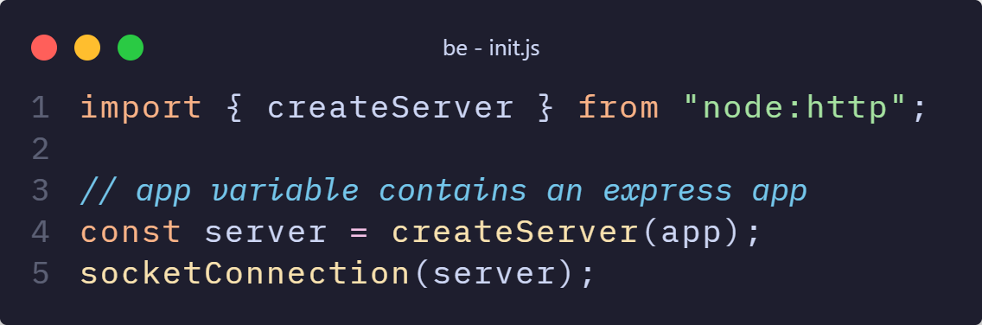
The inner workings – Socket.io – Back-End

Slide 59
The inner workings – Socket.io – Back-End
Import createServer-Function
Use createServer-Function to create a server
Pass the new server to socketConnection

Slide 60
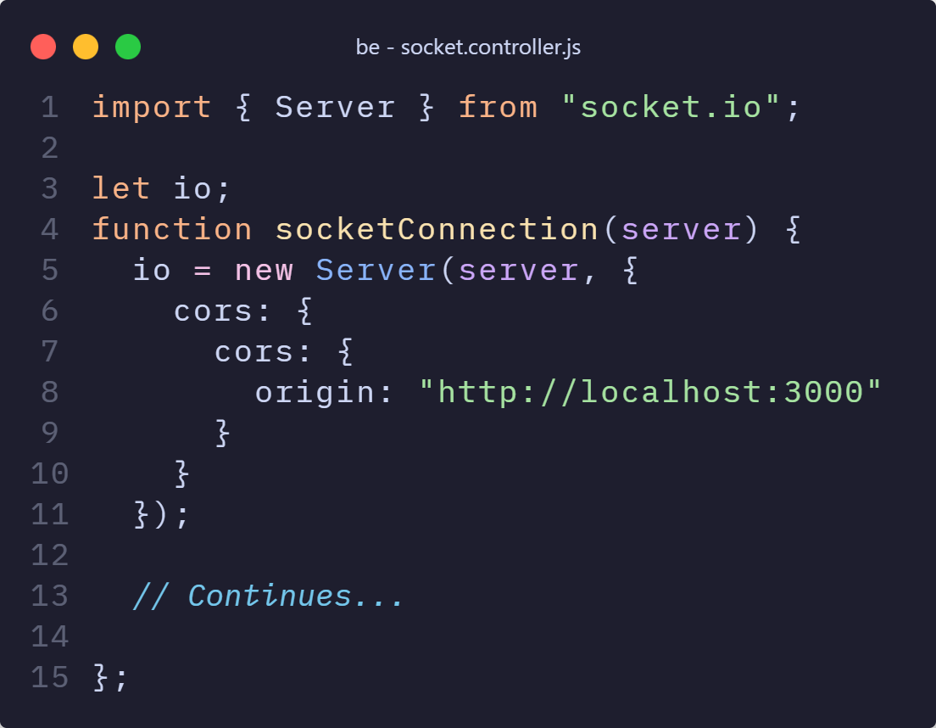
The inner workings – Socket.io – Back-End

Slide 61
The inner workings – Socket.io – Back-End
Import Server from socket.io
Initialize global io variable
Store new socket server with cors configuration in io variable

Slide 62
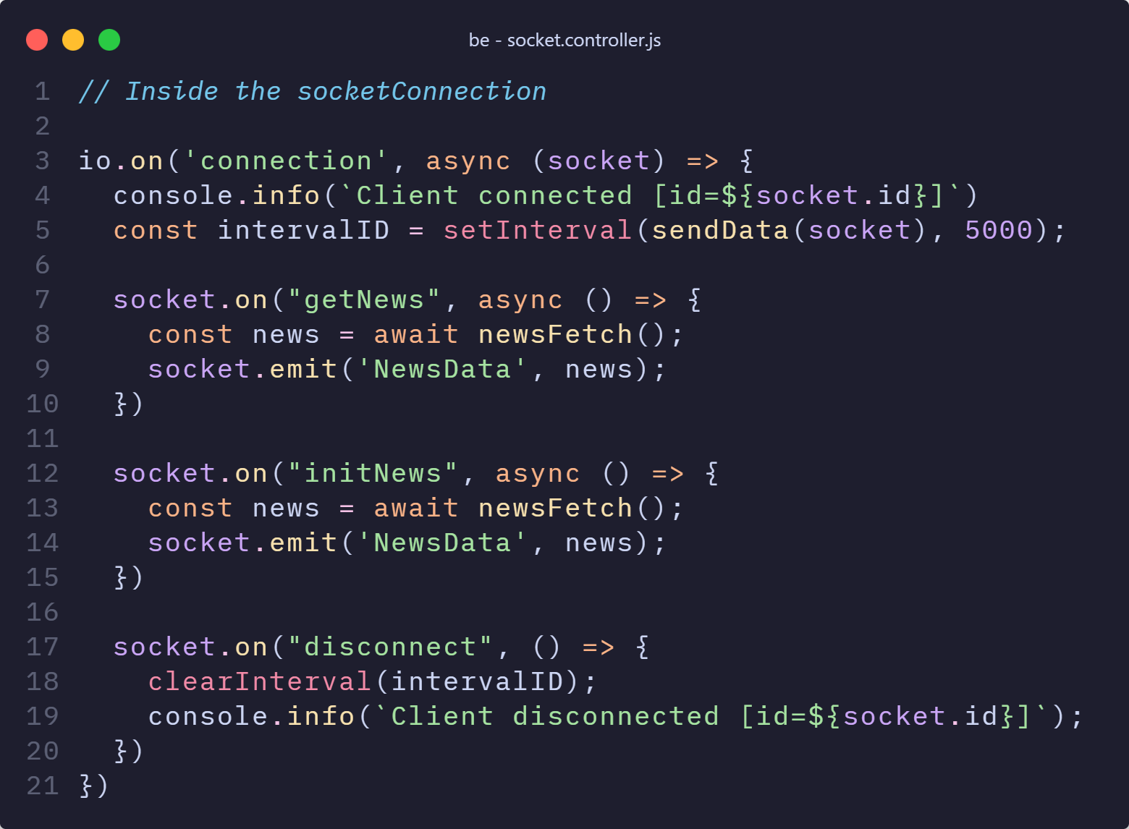
The inner workings – Socket.io – Back-End

Slide 63
The inner workings – Socket.io – Back-End
On the ‘connection’ event execute the following async function
For each connected socket, sent an interval to trigger the sendData function
On the socket event ‘getNews’, trigger a function that emits a socket event with data

Slide 64
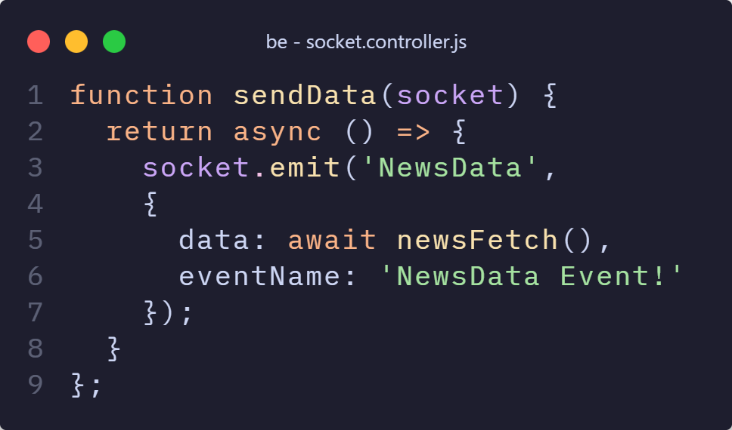

The inner workings – Socket.io – Back-End

Slide 65
The inner workings – Socket.io – Back-End
This must return a call-back function wrapped in a Promise, because setIntervall requires a Promise
newsFetch() is a function that gets some Data from somewhere

Slide 66
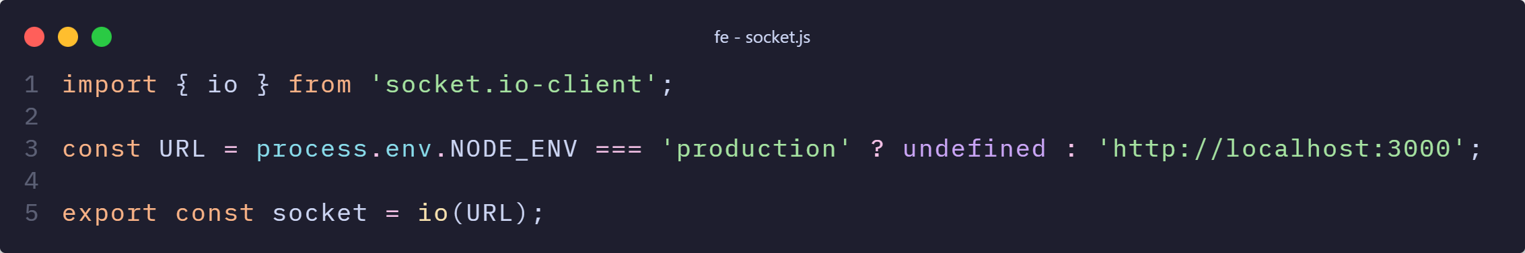
The inner workings – Socket.io – Front-End

Slide 67
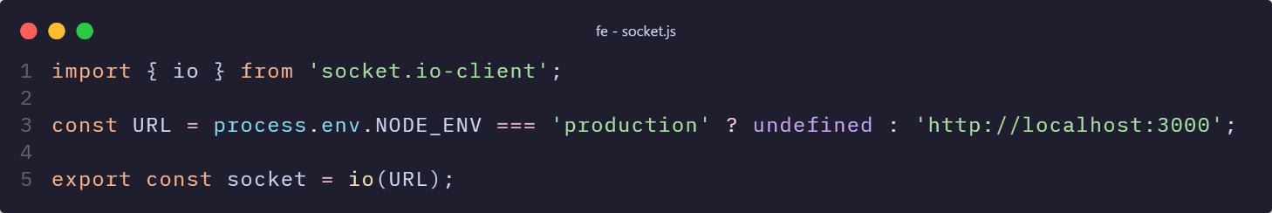
The inner workings – Socket.io – Back-End
Import the server of the client version of socket.io
Pass the URL of the backend to the imported server object

Slide 68
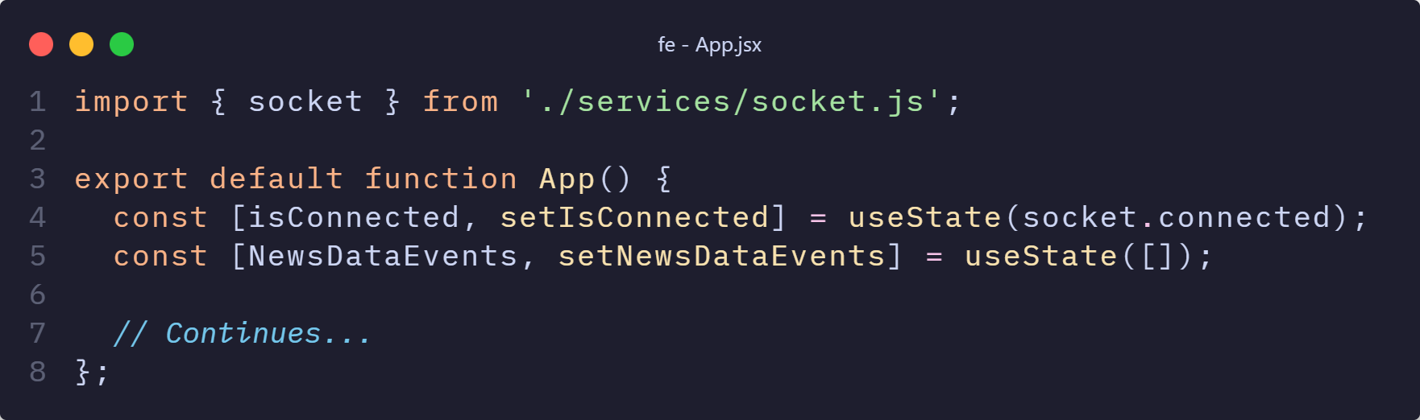
The inner workings – Socket.io – Front-End

Slide 69

The inner workings – Socket.io – Back-End
Import the socket.io server we defined
Initialize the isConnected state with the value of the server field connected

Slide 70
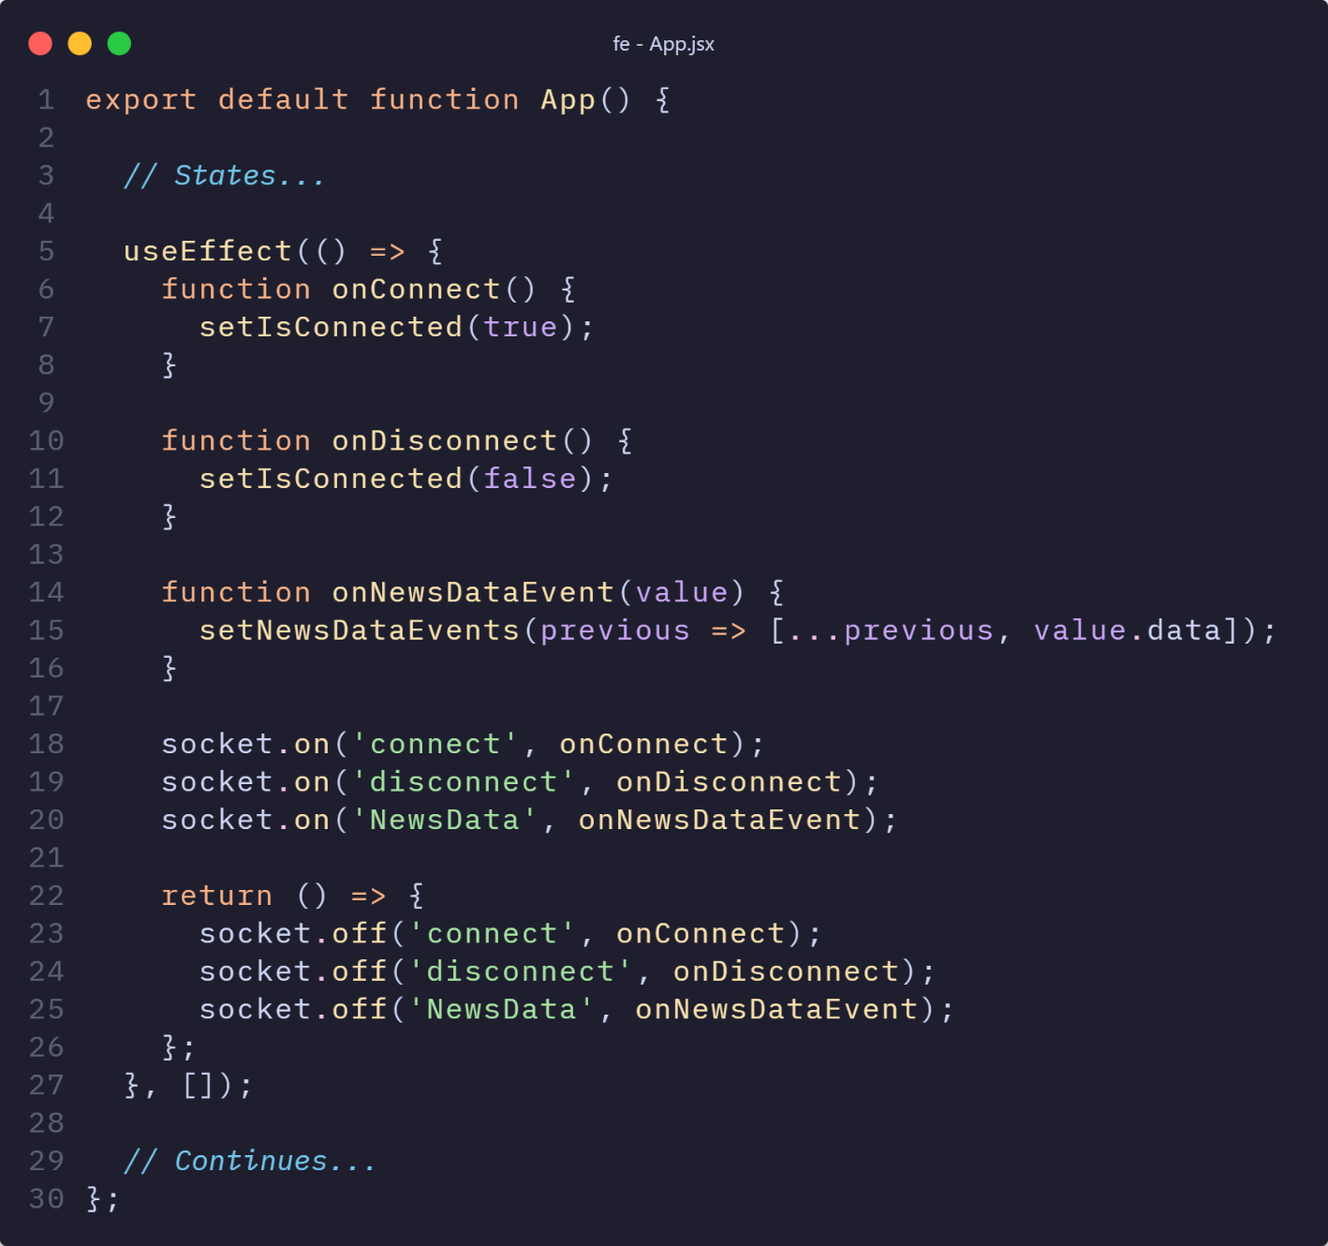
The inner workings – Socket.io – Front-End

Slide 71
The inner workings – Socket.io – Back-End
Define our callback-function we want to trigger on the event NewsData
Tell the socket.io server to listen for the event NewsData and pass the callback-function
Stop listening for the NewsData event if the component gets unrendered

Slide 72
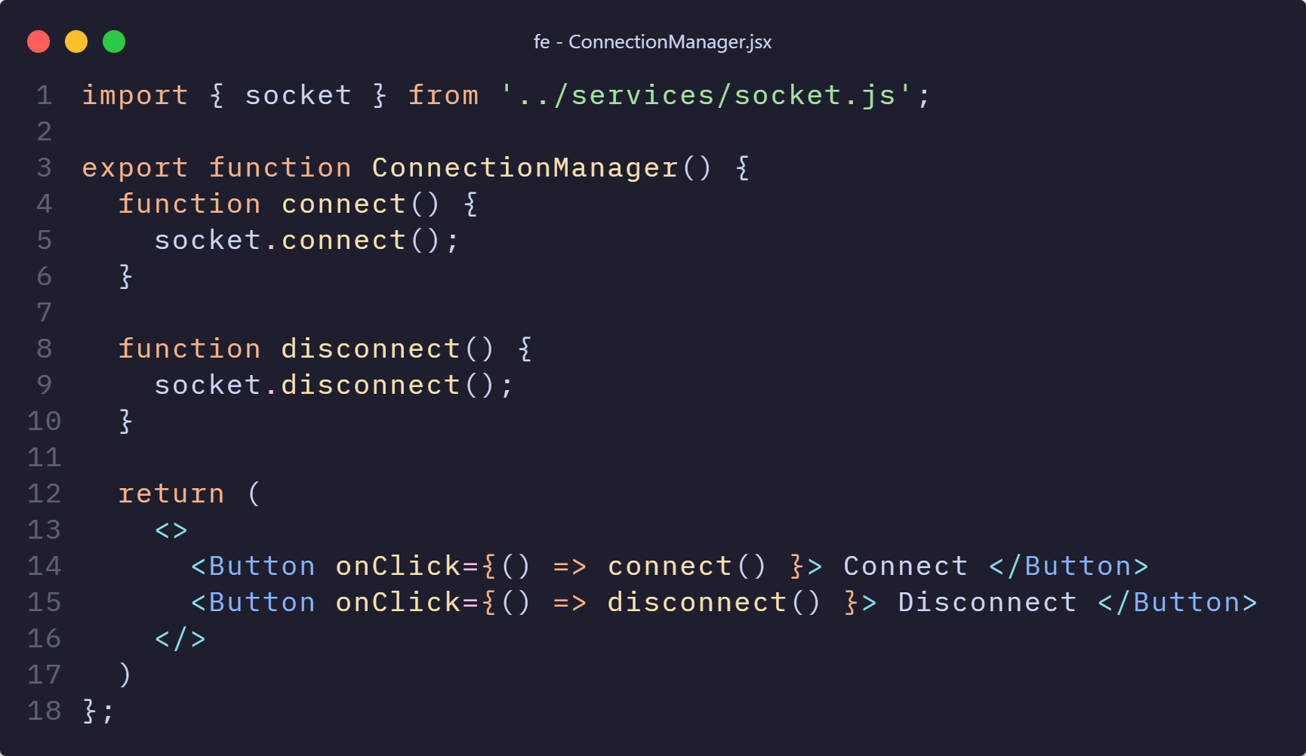
The inner workings – Socket.io – Front-End

Slide 73

The inner workings – Socket.io – Back-End
Import the socket.io server we defined
Connect client socket.io server to backend socket.io server
Trigger connection through a button press

Slide 74

Socket.io – Implementation
Listeners take the form socket.on(<EventName>, <CallBack>)
Emitters take the form of socket.emit(<EventName>, [args])
Both socket.io servers establish ‘listeners’ and ‘emitters’
Front- and Back-End create a socket.io server

Slide 75

Socket.io – Summary
Provides high-level API for WebSocket like interaction
Exists for multiple languages, JavaScript being just one
Requires implementation on Client- and Server-side
Allows for real-time communication
Source: Socket.io [14]

Slide 76
Agenda
Node.js
Express.js
Node.js overview
Socket.io
Express.js overview
Getting Started with Node.js
Comparison & Summary
Controller: Middleware and Routing
View: Templates
Model: Using Mongoose
Discussion & Installation
Notes:
First part: node.js

Slide 77
Express.js overview
A quick overview

Slide 78
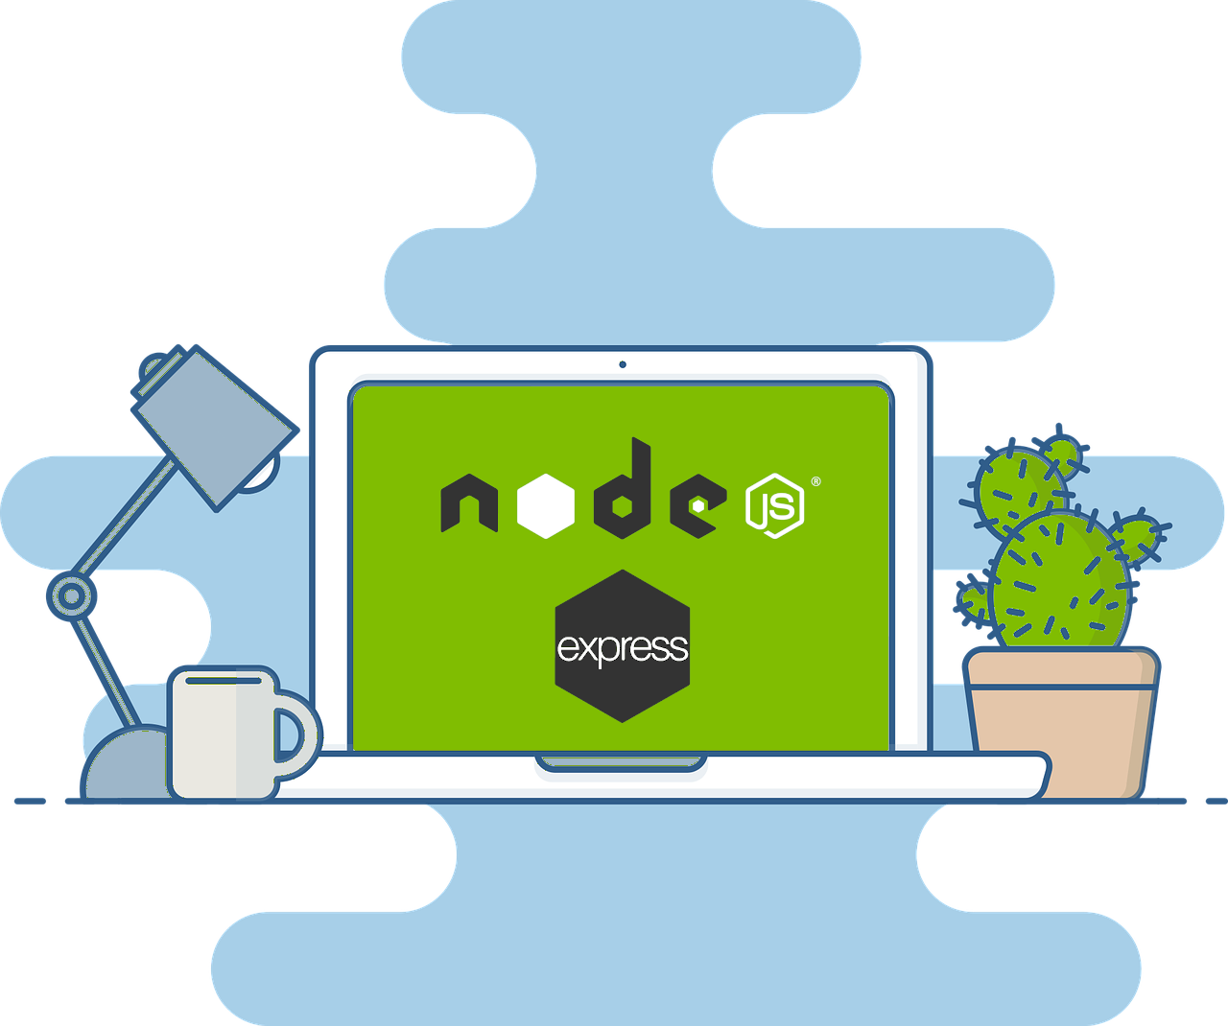
Express.js overview
Minimalistic and Lightweight
Flexibility
Middleware
Routing
Performance
Active Community and Ecosystem
More on Wednesday!
Source: Node.js + Express Tutorial for 2021 [15]

Slide 79
Agenda
Node.js
Express.js
Node.js overview
Socket.io
Express.js overview
Getting Started with Node.js
Comparison & Summary
Controller: Middleware and Routing
View: Templates
Model: Using Mongoose
Discussion & Installation
Notes:
First part: node.js

Slide 80
Getting started with Node & Express
Behold, yet another API

Slide 81


Installation of Node.js & Express.js
Node.js
Express.js
You need an editor of your choice
Download and install Node.js from the official website
Create a new Node.js project
Install Express.js using npm
Notes:
Let’s have a short overview firstly.
You will learn Node.js, socket.io ,express.js and MVC.
after the class, you can build real time online chat application
I will show how to build
step by step.
Other group will introduce more details about express.js this Wednesday.

Slide 82
Agenda
Node.js
Express.js
Node.js overview
Socket.io
Express.js overview
Getting Started with Node.js
Comparison & Summary
Controller: Middleware and Routing
View: Templates
Model: Using Mongoose
Discussion & Installation
Notes:
First part: node.js

Slide 83
Comparison & Summary
The end is nigh

Slide 84
Aspect
Node.js
Python
PHP
Concurrency
Good for async tasks and
Limited, but can be
Struggles with multiple tasks,
but can improve
events
extended
Handles many connections
Not the fastest, but good for
Decent, suitable for small
Performance and scalability
-
well, good for real
-time apps
many tasks
medium apps
Ecosystem & Libraries
Vast
npm
repository , extensive
Rich standard library for web
Large ecosystem
web Api libraries
Learning Curve
Steep for beginners
Relatively easy with
Moderate, potential
readable syntax
inconsistencies
Community Support
Large, active community,
Large community, extensive
Large community, especially
ample resources
docs
for web dev

Slide 85

Summary of node
Large ecosystem of packages
Very versatile
Enables JavaScript for full-stack development
Runtime for JavaScript

Slide 86


Summary of node
Event-driven architecture for real-time applications
Fast execution due to V8 JavaScript engine

Slide 87
References
Node.js, Links: https://nodejs.org/docs/latest/api/ & https://nodejs.org/en/about/branding, Viewed 25.05.2024
Casciaro, M., & Mammino, L. (2020). Node. js Design Patterns: Design and Implement Production-Grade Node. js Applications Using Proven Patterns and Techniques, 3rd Edition (3rd ed.). Packt Publishing, Limited.
Kirill Bobrov. (2024). Grokking Concurrency. Manning Publications.
Group Webscope, Lecture on Node.js, SoSe23 Link: https://uni-duisburg-essen.sciebo.de/s/SvQcX3xKSCNFJW8?path=%2Fss-23%2Flecture#pdfviewer, Viewed 25.05.2024
JavaScript use-cases and most popular technologies used with JavaScript, A. Pour, Link: https://dev.to/devaddict/javascript-use-cases-and-most-popular-technologies-used-with-javascript-10j3, Viewed 25.05.2024

Slide 88
References
10 Reasons To Learn Node.js In 2024, GeeksforGeeks Inc. Link: https://www.geeksforgeeks.org/reasons-to-learn-node-js/, Viewed 25.05.2024
Libuv Link: https://docs.libuv.org/en/v1.x/design.html, Viewed 25.05.2024
Node.js Internals: Not everything happens on the thread pool, G. Haxhi Link: https://medium.com/softup-technologies/node-js-internals-not-everything-happens-on-the-thread-pool-a14d0a286efb, Viewed 25.05.2024
Setting Up MongoDB with Express.js: A Step-by-Step Guide, V. Mishra, Link: https://blog.stackademic.com/setting-up-mongodb-with-express-js-a-step-by-step-guide-8eb8fd80d5ff, Viewed 25.05.2024
Create a backend in Javascript (part 6): How NodeJS work under the hood? Link: https://dev.to/ericchapman/create-a-backend-in-javascript-part-6-how-nodejs-work-under-the-hood-2l3l, Viewed 25.05.2024

Slide 89
References
NodeJS Modules| How to create Modules in Nodejs, Knoldus Inc. Link: https://blog.knoldus.com/nodejs-modules-how-to-create-modules-in-nodejs/, Viewed 25.05.2024
TCP protocol https://www.ietf.org/rfc/rfc793.txt, Viewed 25.05.2024
WebSocket Protocol, Link: https://datatracker.ietf.org/doc/html/rfc6455, Viewed 25.05.2024
Socket.io, Link: https://socket.io/, Viewed 25.05.2024
Node.js + Express Tutorial for 2021, C.Pit, Link: https://www.pullrequest.com/blog/nodejs-express-tutorial-for-2021/, Viewed 25.05.2024

Slide 90
References – Unused on slides
Uzayr, S. bin. (2024). Conquering JavaScript: Node.js (1st ed., Vol. 1). CRC Press. https://doi.org/10.1201/9781003357469
Craig Buckler. (2022). Node.js: Novice to Ninja. SitePoint.

